Slide 1
PUBLIC WORKS JOBS AVAILABE NOW!

Slide 2
What is Public Works?
Public Works encompasses everything people in local government do to provide and sustain the structures and services we count on for an acceptable quality of life.

Slide 3
Public works professionals take care of our:
Streets
Water distribution and wastewater treatment
Traffic and transportation
Engineering and technology
Solid waste management
Construction management
Fleet management
Facilities
Parks and grounds
Emergency management

Slide 4
Who am I?
Explain your role in Public Works, refer to section 2 of the Student Outreach Presentation for helpful suggestions to share.

Slide 5
What field would you enter to work in Public Works?
Administration and Management
Construction Management
Emergency Management
Engineering and Technology
Facilities, Grounds and Urban Forestry
Fleet Services
Public Rights-of-Way
Solid Waste
Transportation
Water Resources (Drinking water, Stormwater and Wastewater)

Slide 6
Administration and Management
In the realm of public works, there are many careers in leadership, administration, and management that are needed and that have an enormous influence and impact on our communities’ well-being. Every area of public works employs managers to supervise and oversee projects and day-to-day operations. Leaders and laborers work together to make public works successful.

Slide 7
Construction Management
Behind every great city is a team of planners, municipal engineers, technicians, managers, equipment operators, and workers who design, build, and maintain the buildings, parks, and infrastructure that allow its citizens to live, work, and play with ease. Construction management involves the supervision and maintenance of all phases and elements of construction of public buildings and other public places like parks, libraries, government offices, recreation centers and water plants.

Slide 8
Emergency Management
One of the most important responsibilities of municipal government is the safety of its citizens during emergency situations. What are these possible emergencies? Floods? Snowstorms? Earthquakes? Hurricanes? Brush fires? Landslides? Terrorist attacks? Pandemics? Public works personnel are among the first to respond to emergencies such as waterline breaks, tornadoes, earthquakes, and ice storms.
They also design emergency response plans to prepare communities before emergencies and disasters strike. These plans ensure that all emergency personnel can arrive at the scene safely, communicate with one another, restore services as soon as possible, and minimize the effects of the disaster.

Slide 9
Engineering & Technology
Engineering and technology covers a broad spectrum of duties, including civil engineering, communications, traffic, electronics, management, IT, and structures. Engineering technology workers use geometry, calculus, trigonometry, physics and information technology to design buildings, water and sewer systems, roads, and bridges.

Slide 10
Facilities, Grounds & Urban Forestry
Facilities is the area of public works concerned with keeping public buildings open for business. City-owned properties, from public buildings and parks to water treatment facilities, must be maintained in good working condition. Public works employees keep your community livable and beautiful. There are many people who work in a variety of jobs in government offices, power plants, water treatment facilities and other public buildings.

Slide 11
Fleet Services
Everything from heavy equipment to emergency response vehicles to electric sedans used by employees make up the government fleet and must be managed and maintained economically and in safe, reliable condition. This area of public works is responsible for the repair and maintenance of all public works vehicles and equipment. This requires a team of people with wide-ranging skills — technical skills to maintain diverse vehicles, management skills to organize work and resources, and financial skills to balance resources and costs.

Slide 12
Public Rights-Of-Way
Public rights-of-way typically refers to land set aside for sidewalks, roadways, and utility infrastructure. Utility infrastructure includes facilities that carry water, electricity, telecommunications, natural gas, wastewater/drainage, and other utilities to and from our homes and workplaces. All pipes, wires, services, and poles existing within this right-of-way must be permitted, located, and maintained. Updated technology and general maintenance requires aging infrastructure to be redesigned and replaced. Growing communities require expansion of infrastructure. Employees in this field permit, install, inspect, manage, locate, and maintain these facilities.

Slide 13
Solid Waste
One of the major challenges any city faces is the safe disposal or recycling of the solid waste its citizens generate every day. This involves a wide range of challenging jobs from planning systems and developing technology to collecting waste and operating waste facilities. Solid waste management is an area of public works that supervises the hauling, processing, and disposing of recyclables, yard waste and trash in safe and environmentally sustainable ways.

Slide 14
Transportation
The larger a city or town, the more important it is to have a comprehensive multimodal transportation system — streets, walkways, bike routes, and mass transit — that moves people efficiently, but also minimizes air pollution and other environmental damage. Public works employees keep communities moving making it possible for all of us to get where we need to go on time and with minimal frustration.

Slide 15
Water Resources
Water is our most precious resource, and the management of water resources is critically important to the health and well-being of our communities. Water is treated and distributed as safe drinking water and then collected as wastewater to be processed by a sewage treatment plant. Stormwater is managed to minimize pollution and flooding hazards. This area of responsibility involves providing citizens with clean drinking water, managing stormwater run-off, and removing and treating wastewater to protect the environment.

Slide 16
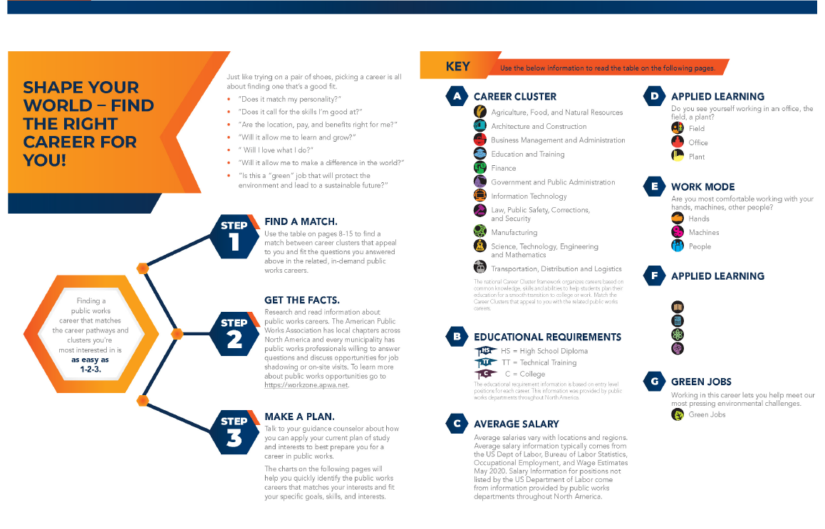
Find the Right Career for You!
FIND A MATCH.
Use the table on pages 8-15 to find a match between career clusters that appeal to you.

Slide 17
Discuss and Share…

Slide 18
PLAN IT! DO IT! MAKE THE FUTURE HAPPEN!
Check the availability of internships and jobs in public works – Visit your city or town’s website or call your local public works department and ask about summer internships or jobs.
Meet with your counselor to map out your career path – Courses you take in high school and college will prepare you to enter the world of public works.
Contact the American Public Works Association (APWA) for resources about careers in public works. www.apwa.net
Contact your local APWA chapter (see www.apwa.net for a list of chapters across the U.S. and Canada) — Learn about opportunities for mentoring, internships, job shadowing, or school presentations or tours offered by APWA members in your area. These activities and events will give you hands-on experience with public works jobs.

Slide 19
Questions?

