Slide 1
APWA Chapter Education Resources

Slide 2
Introduce the Team:
Katherine Anderson, Education and Speaker Development Specialist (eLearning and Certificates)
Deanne Cross, Associate Director of Education
Summer Simmons, Education and Speaker Development Specialist (CLLs and Workshops)
Sam Tasker, Conference Education Associate (Chapter CEU Applications, Snow and PWX Speaker Management)

Slide 3
Program Learning Objectives
Following this program, participants will better be able to:
Identify the education programs and resources available to chapters from APWA.
Discuss the optimal way to use APWA education programs and resources to maximize their benefits to the chapter.
Employ educationally sound practices when holding chapter education and training programs.

Slide 4
Ready Made Programming

Slide 5
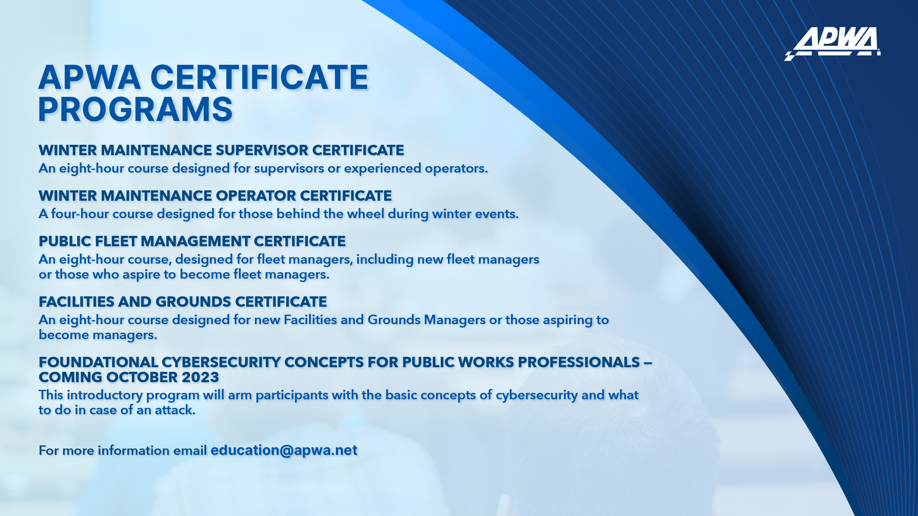

Slide 6
Certificate Programs
Winter Maintenance Fleet and F&G
Content Use Fee (1x) Content Use Fee (1x)
Must use approved Local experts can
speakers present w/detailed facilitator guide

Slide 7


Slide 8

20% off in June with SALE23

Slide 9


Slide 10
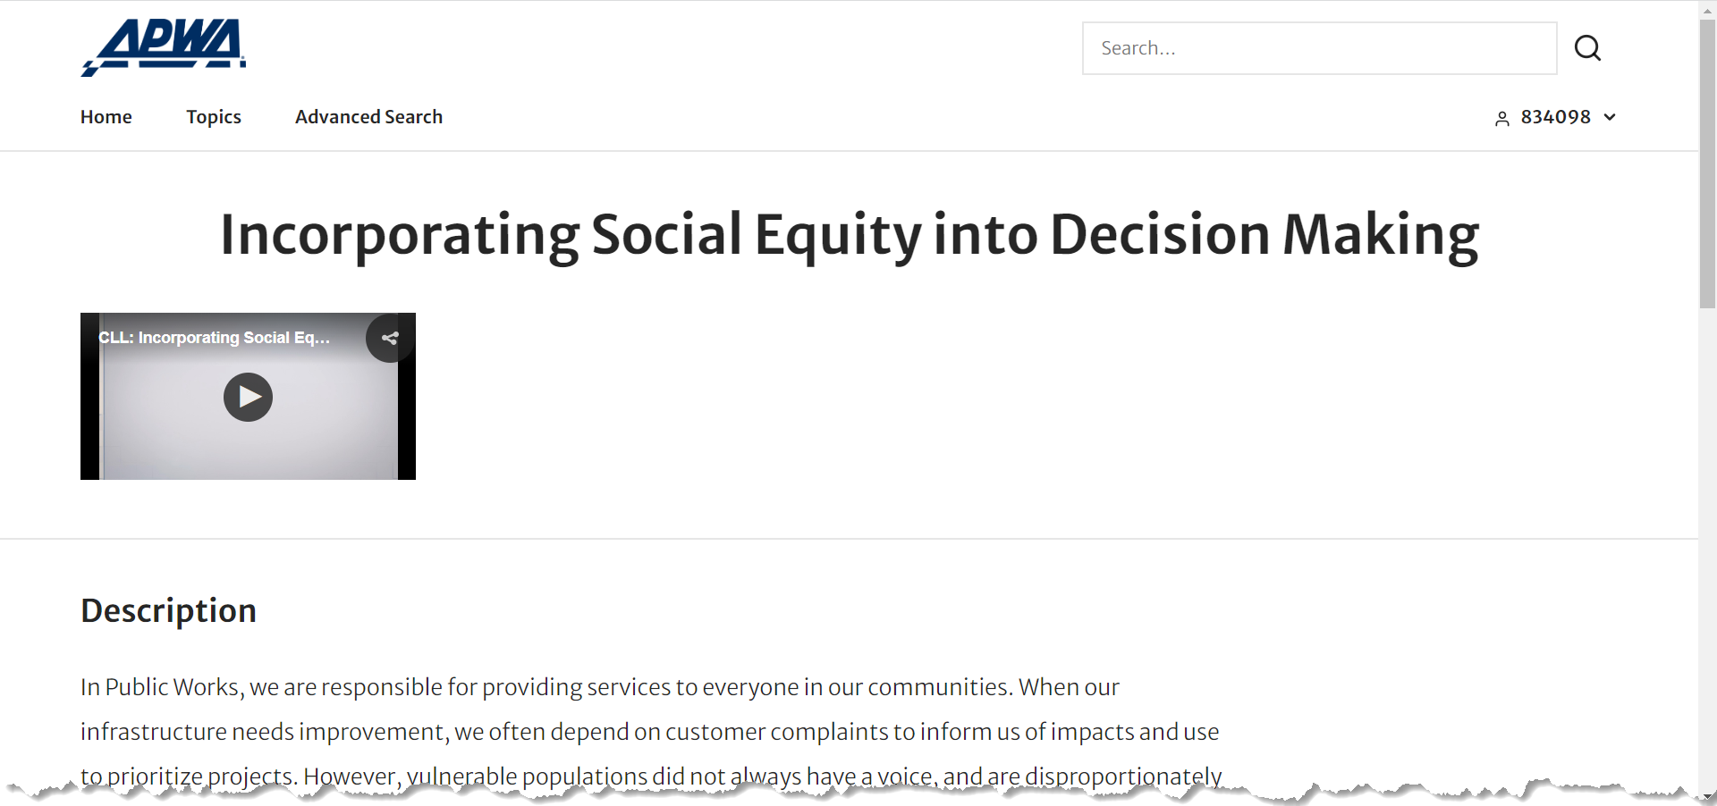
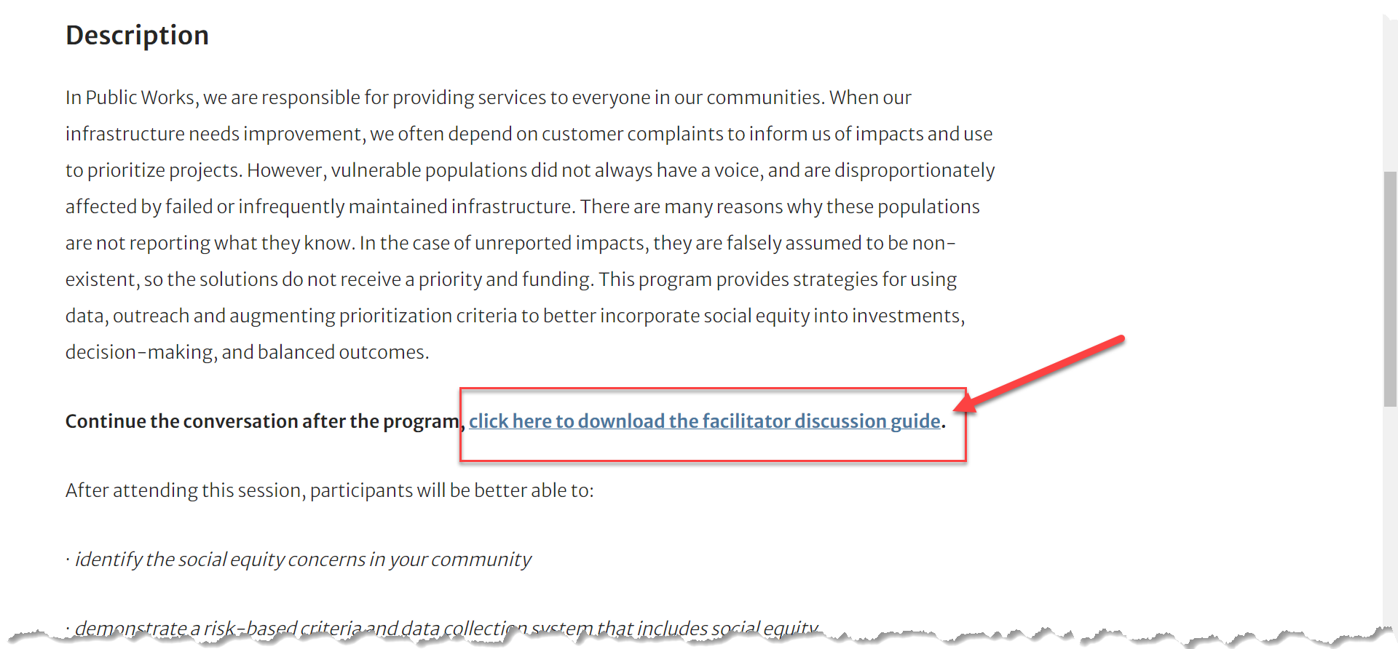

Slide 11
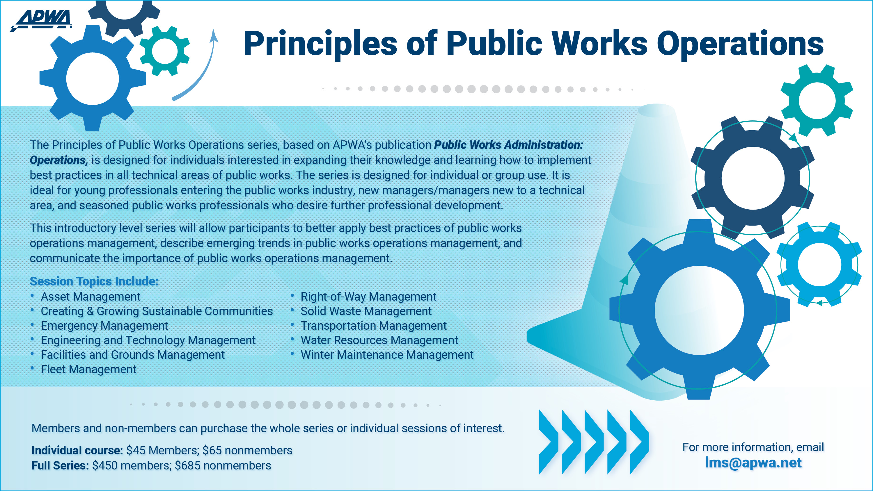

20% off in June with SALE23

Slide 12
Resources to Strengthen Your Educational Programs

Slide 13
Speaker Resources
Knowledge and Skill Levels
Learning Objectives

Slide 14
Continuing Education Units: CEUs
CEUs vs. PDHs
Why offer CEUs?
CEU approval process
Tips for Approval Process:
  Agenda Times
  Welcome, Introductions, and APWA Specific Information ≠ Educational Time
  Learning Objective Verbs
Incorporating CEU approval process components can ensure higher quality education.

Slide 15
Questions?

Slide 16
Breakout Questions
What one program or resource would you like your chapter to use?
What resource or need would be helpful for your chapter?

