Slide 1
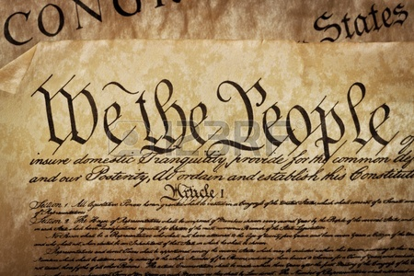
Why Advocate?
If not you, who?
Limited Resources – Be a resource
Power in numbers – chapters
You & Your Community
Increases YOUR Professional Value
It is Easy, and More Fun than You Think
It is About Relationships

Slide 2
Your Role as a Chapter Leader
Identify priorities
Form a chapter Government Affairs Committee/Public Works Awareness Committee
Develop a Plan
  Connect with other APWA chapters
Identify Partners
  Colleagues
  Elected and appointed officials
  Media
  Like minded groups
  The public

Slide 3
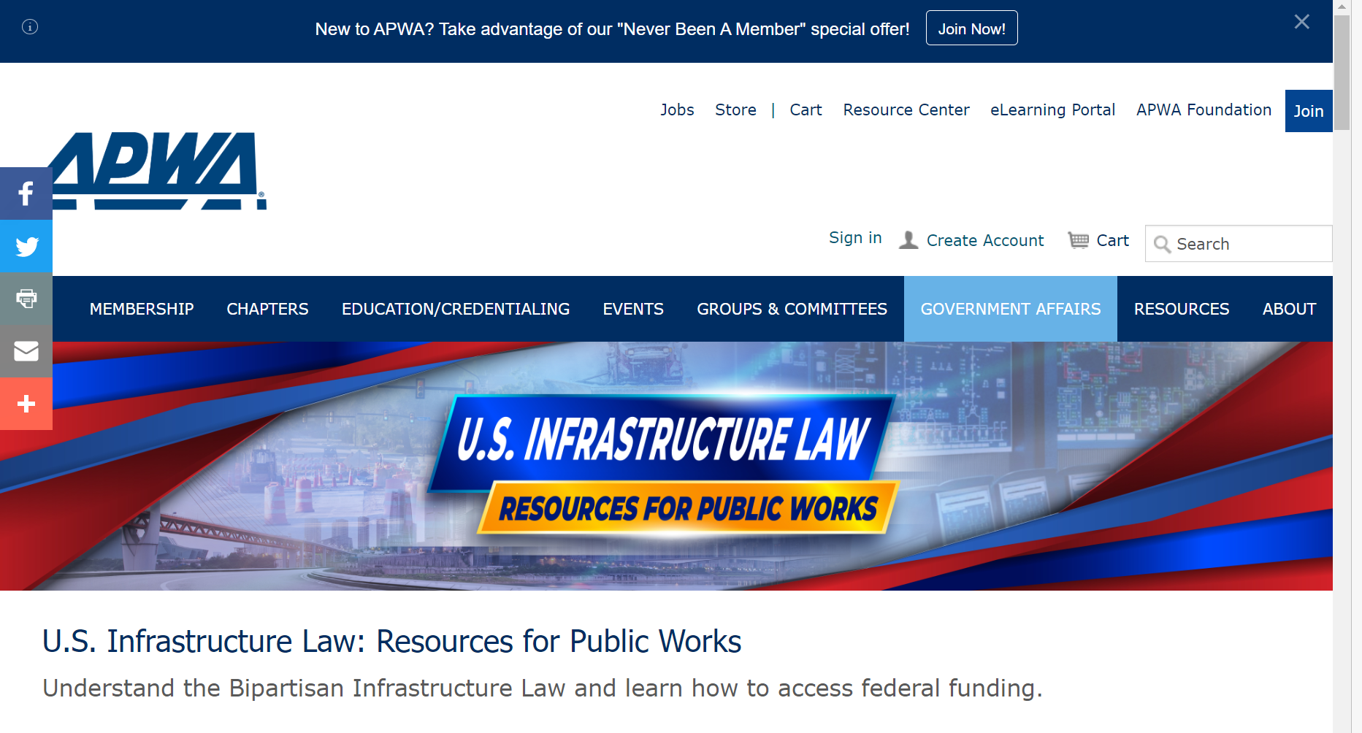
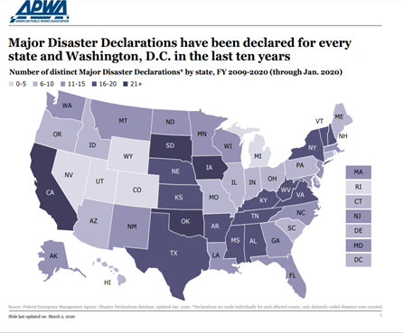
APWA Resources
APWA Government Affairs Staff
Government Affairs Committee
APWA Advocacy Ambassadors
IIJA Resource page and webinars
Public Works Research products
The Reporter
  ‘Washington Insight’, ‘GAC Insight’, PW Awareness’ columns
InfoNow Communities

Slide 4
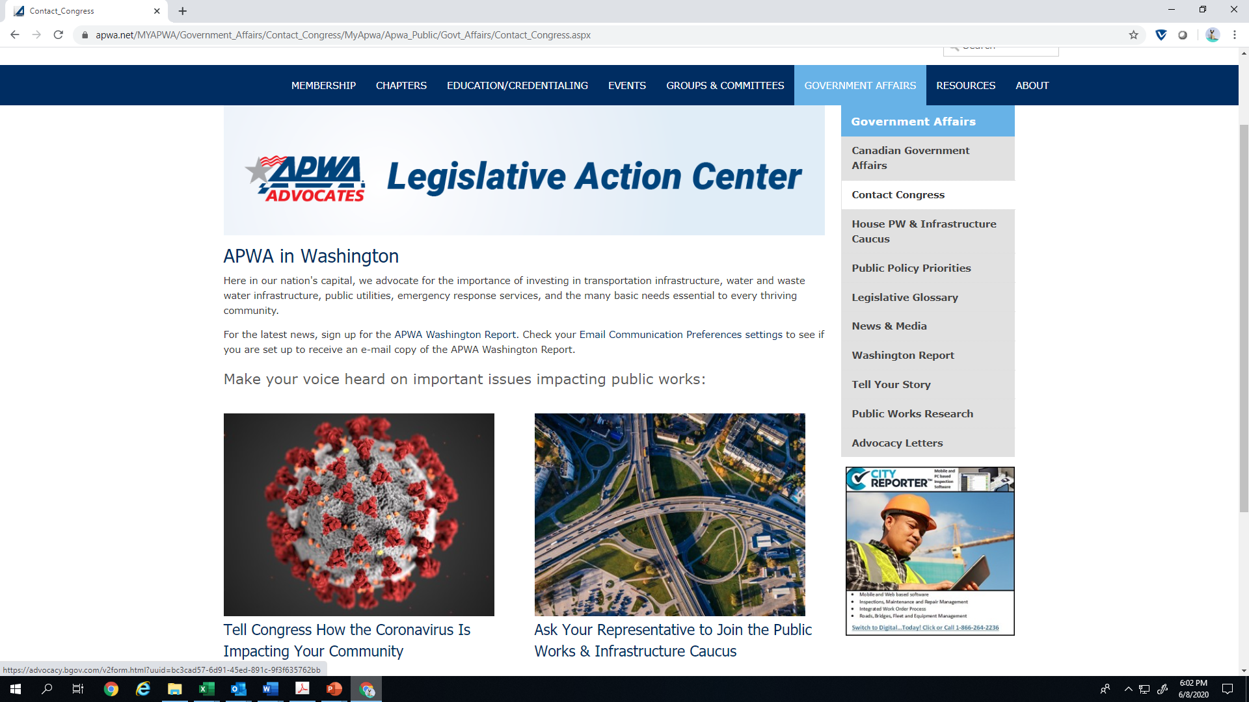
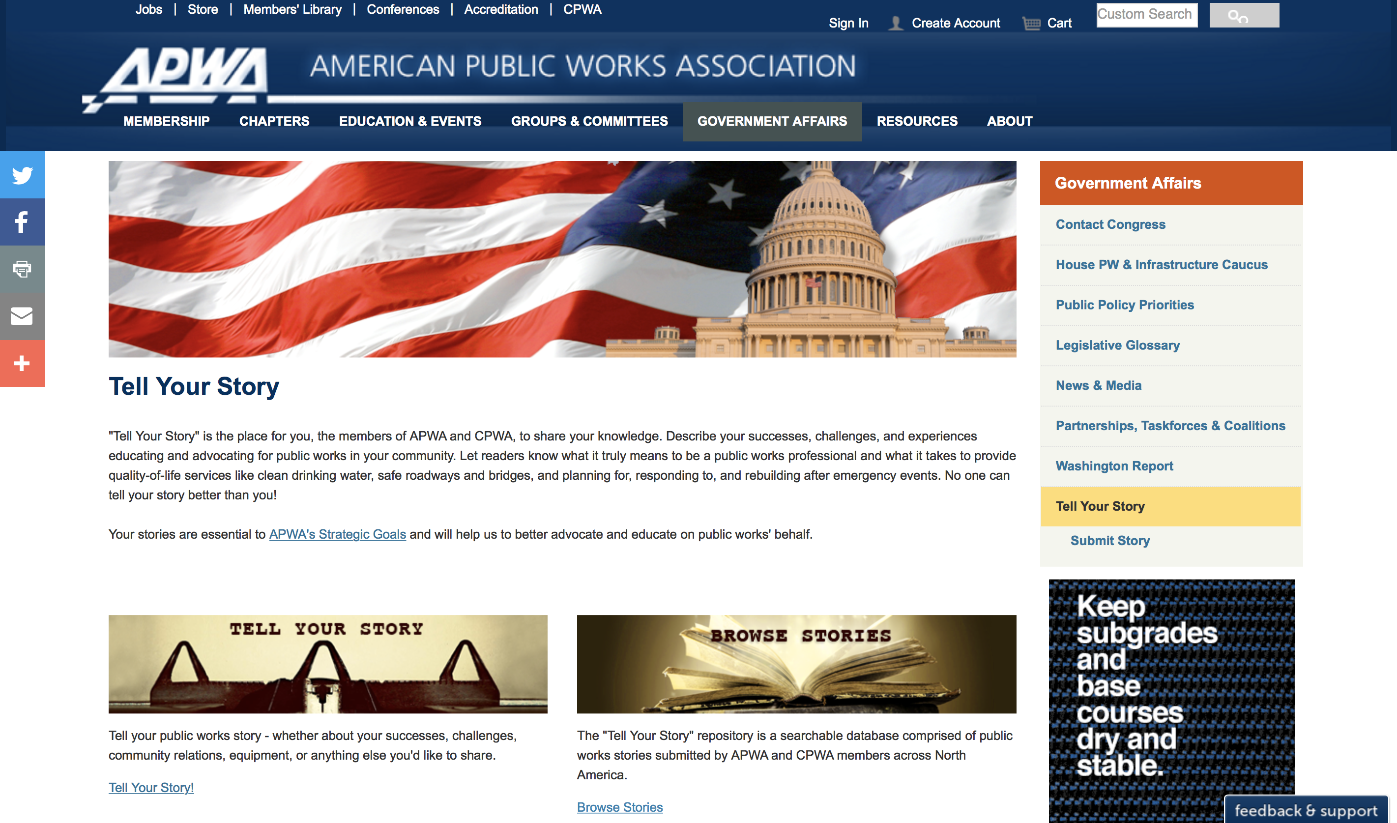
APWA Resources continued
Action alerts – text PWX to 52886
APWA Washington Report
@APWAGOVAFFAIRS on Twitter
Public Works & Infrastructure Caucus
‘Tell Your Story’

Slide 5
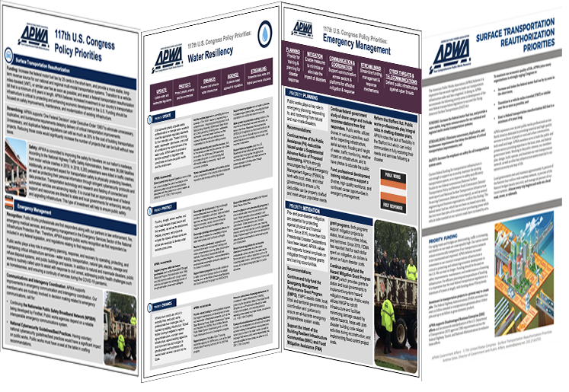
Federal Outreach 101
Key Positions—District Office
  Chief of Staff
  District Director
  Constituent Services Director
  Constituent Services Representative
  Email and Call
Key Positions—DC Office
  Chief of Staff
  Legislative Director
  Scheduler (may handle DC and District offices)
  Legislative Assistant
  Legislative Correspondent
  Email and Call

Slide 6
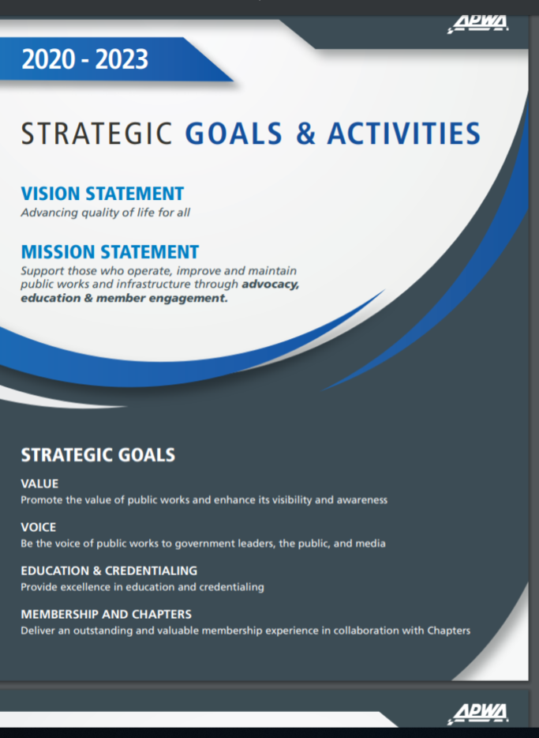
Ideas
Establish a Chapter Government Affairs Committee
Align with APWA Strategic Plan and Public Policy Priorities
  Be ‘the voice’ of public works
Consistently Invite Elected Officials to Chapter Events
Create “Fabulous Facts” about Chapter/Community
Reach out to other Public Officials/Community Leaders
Know your Legislature’s Schedule and Participate

