Slide 1
Chapter Leader Resources 101
Monday, February 9, 2026
12 Noon Central

Slide 2
Learning Objectives
Understand where to locate APWA Chapter Leader Resources on the APWA website.
Understand where to access Fonteva to build an event, run event registration reports, and run membership reports.
Understand where to log into Word Press, to create and manage content for your chapter website.

Slide 3


Slide 4
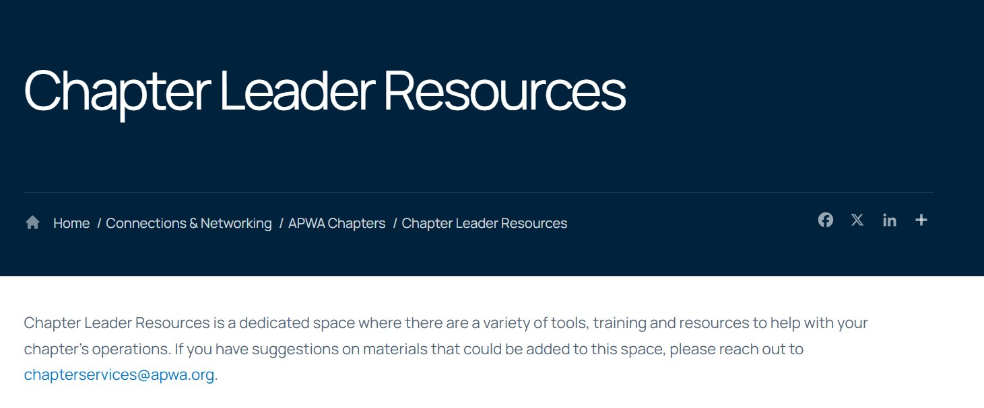

Slide 5
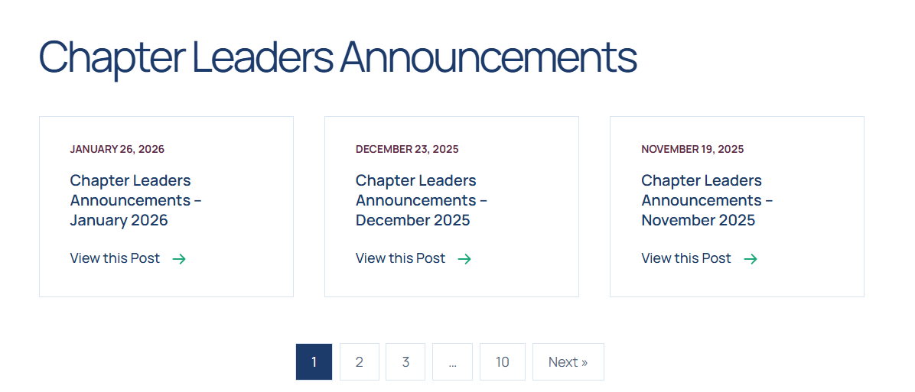

Slide 6
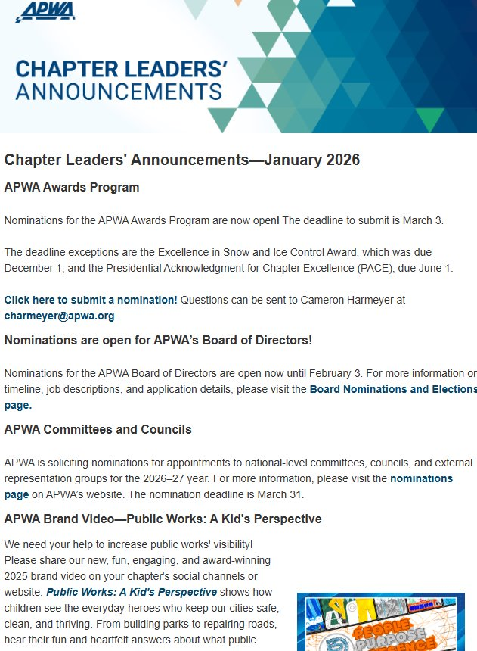

Slide 7
Insurance Update!
APWA has secured a blanket insurance policy covering Roadeos from January 15, 2026, through January 14, 2027.
We’ve negotiated a low, flat cost of $960 per event, providing protection for participants and peace of mind for your chapter. APWA will invoice the chapter/branch treasurer unless an alternate billing contact has been designated.

Slide 8
Insurance Update!
Here’s how it works:
Fill out the Chapter/Branch Roadeo Information Form at least 30 days prior to your event.
Submit the form at least 30 days prior to your event start date to chapterservices@apwa.org
You’ll receive a certificate of insurance within 48 hours of submission.

Slide 9
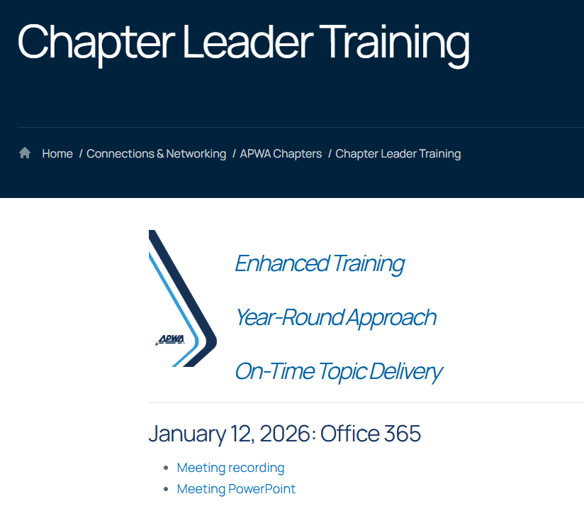

Slide 10


Slide 11

chapterservices@apwa.org

Slide 12


Slide 13
Chapter Services……..
Chapter Executive Officers List
Insurance Requests
Contract Review
Chapter Minutes
Surveys
Election Polls
APWA Videos
ALL OTHER REQUESTS

Slide 14
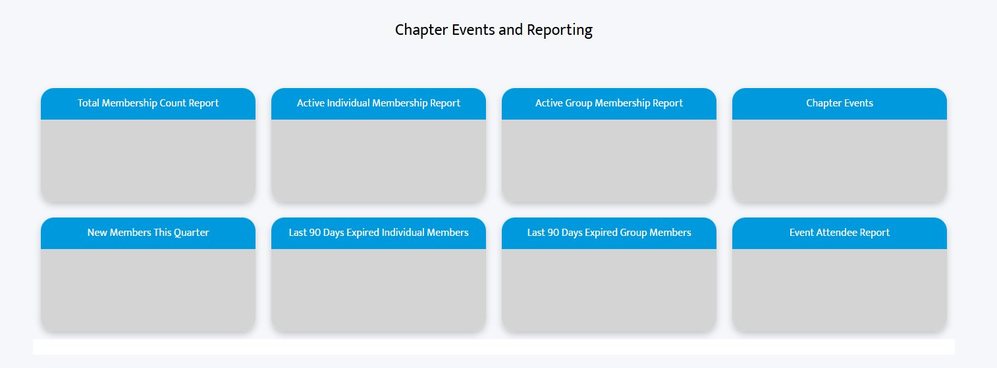
Fonteva
Build Events
Pull Event Registration Reports
Pull Membership Reports

Slide 15
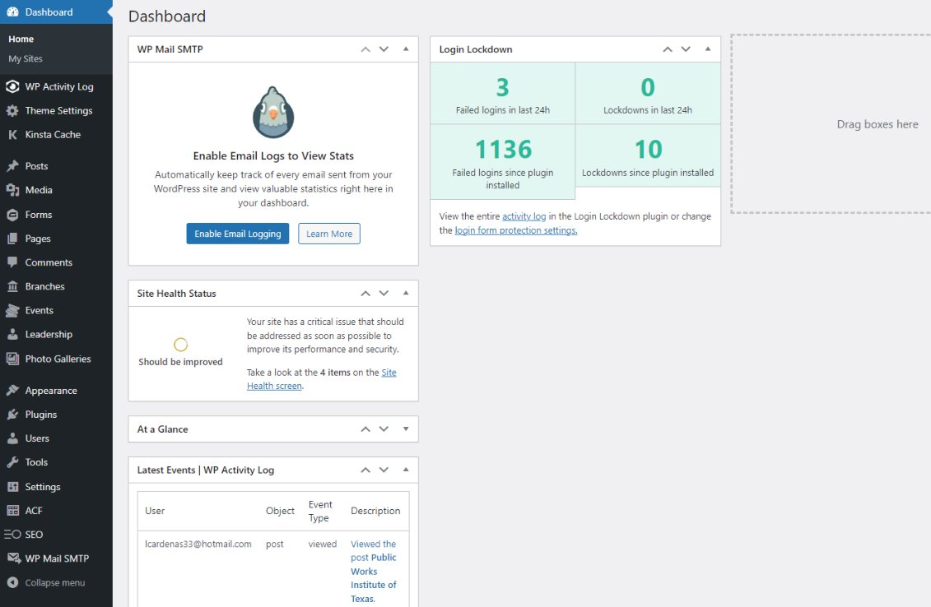
Word Press

Slide 16


