Slide 1
2024 Awards Program

Slide 2
Award Objectives
Changes in the 2024 Awards Program
Locating Awards on the APWA Website
Create or refine chapter awards program
Identify multiple ways award winners are recognized locally and nationally

Slide 3
Poll Question – Does your chapter have an awards committee yes/no?

Slide 4
Award Deadlines
December 4, 2023, (11:59 pm eastern)
Excellence in Snow and Ice Control Award
March 4, 2024, (11:59 pm eastern)
Top Ten Public Works Leaders of the Year
Public Works Projects of the Year
All other awards except the PACE
June 3, 2024, (11:59 pm eastern)
Presidential Award for Chapter Excellence (PACE)

Slide 6
Awards that have been retired
Community Involvement Award
Distinguished Service to Public Works
Exceptional Performance Award in all categories
International Service Award
Donald C. Stone Award for Excellence in Education for the category for Chapters was discontinued. EXCEPTION the category for individuals was kept with the name change to Excellence in Education Award.

Slide 7
Awards that have Name changes
Donald C. Stone Award for Excellence in Education for Chapters. The name of Donald C. Stone was dropped the award changed to Excellence in Education and recognizes only individuals (no longer recognizes chapters)
Harry S. Swearingen’s name was removed and now is called Outstanding Chapter Achievement and Excellence in Chapter Service Award
Commendation for Exemplary Service to Public Works has been changed to Distinguished Service to Public Works Award

Slide 8
Award Criteria changes
Distinguished Service to Public Works Award (formerly the Commendation for Exemplary Service to Public Works) nominations are now reviewed and approved by the APWA Board of Directors.
Public Works Projects of the Year for SC/RC (Small Cities/Rural Communities) the population requirement was reduced from 75,000 or less to 50,000 or less.

Slide 9
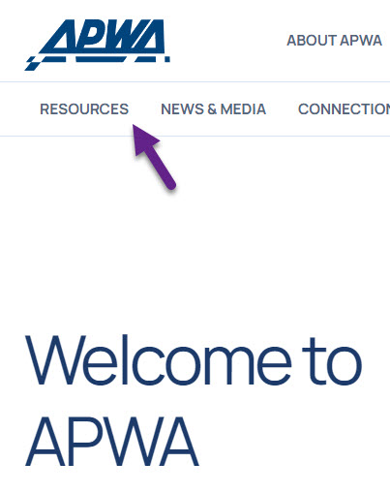
Where to locate Awards Criteria on APWA.org

Slide 10
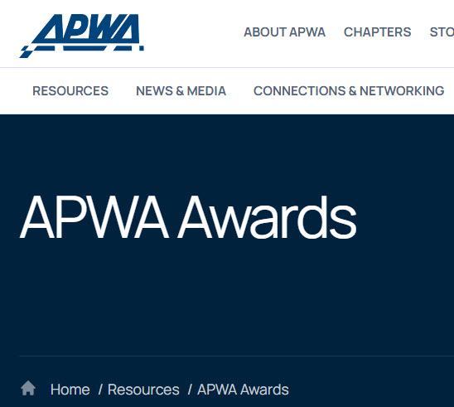
This is the Awards home page. Scroll down to view award choices

Slide 11
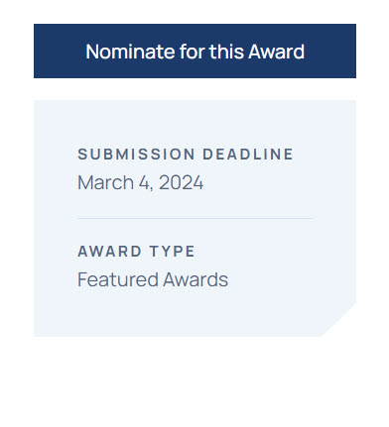
Every criteria page has this box on the right. To submit your nomination choose Nominate for this Award.

Slide 12
Chapter Award Committee Resources
Chapter Awards Program Manual-online
National Award Recognition – Handout
How to Submit an Awards Nomination - Handout
For samples of nominations from past award winner’s email rwilhite@apwa.org and note which award you need.

Slide 13
Breakout Rooms
What are the Challenges in your chapter awards program?
What award recognition practices have been well received in your chapter?
How do you promote your awards to non-members?

Slide 14
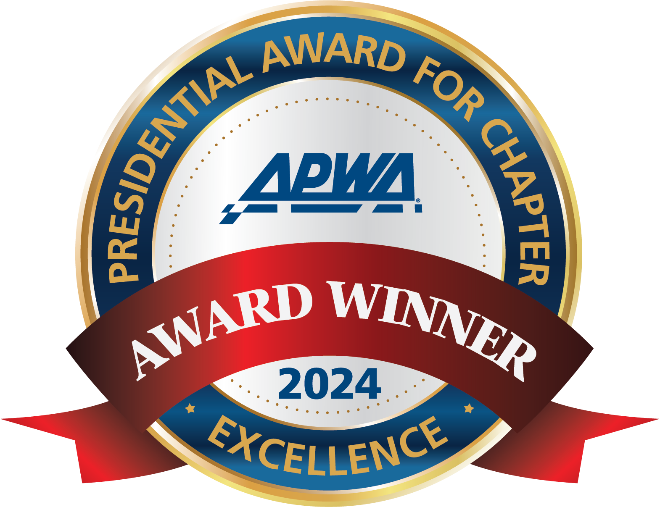
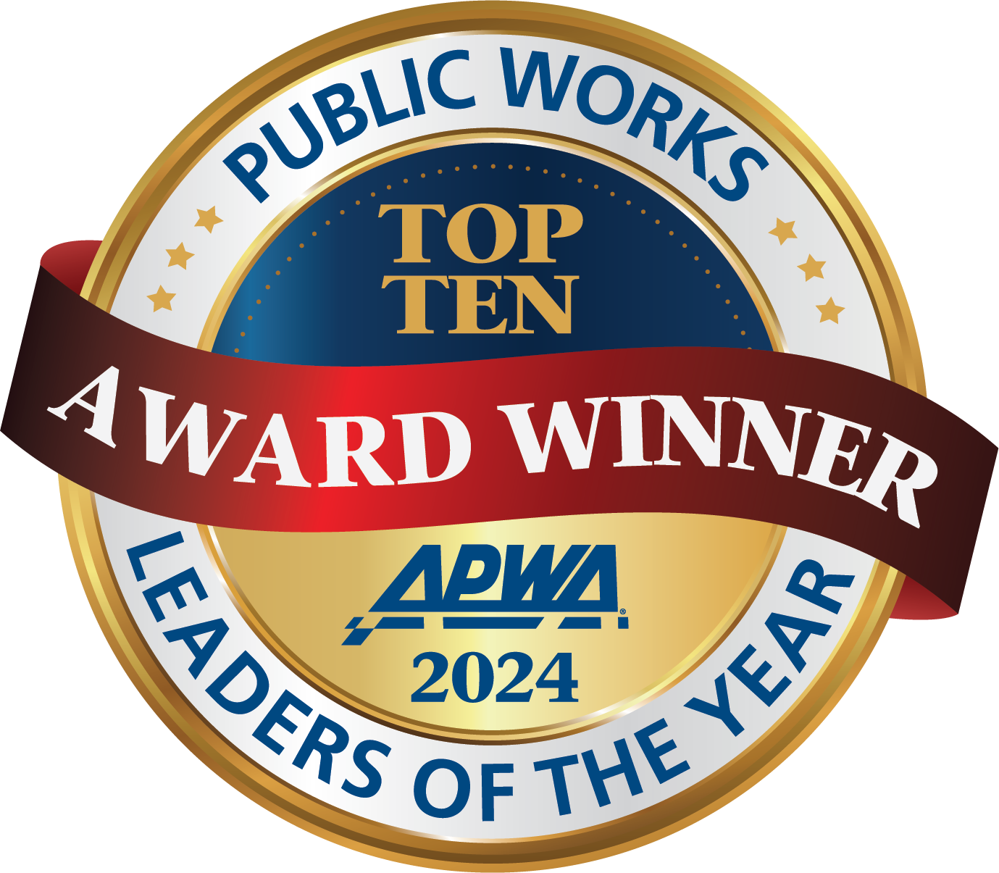
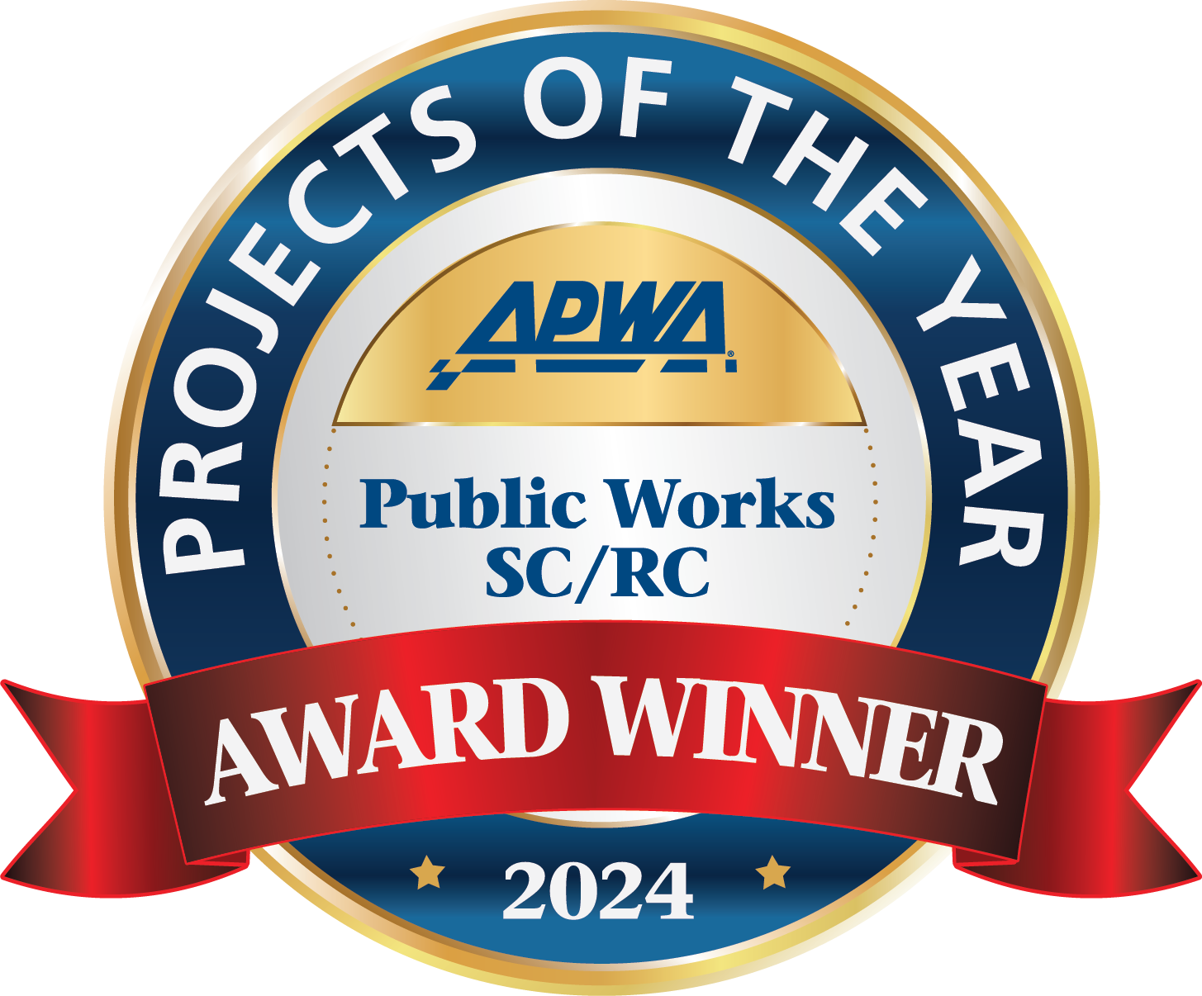
New Items of Recognition for 2024

Slide 15
National Award Committees
Awards Committee, five judges who select all awards except the Top Ten Public Works Leaders, Projects of the Year, Excellence in Snow and Ice and the Professional Manager of the Year awards.
Top Ten Public Works Leaders of the Year, you must be a Top Ten recipient to be a judge on this committee of five members.
Public Works Projects of the Year, twenty members that will break out into four groups of five. Each group are assigned certain categories to judge.

Slide 16
Questions or assistance please contact Rhonda Wilhite at rwilhite@apwa.org

