Slide 1
The Art of Speaking Up

Slide 2

Groundwork

Slide 3

Strategic Goals
Vision
Value
Voice
Education/Credentialling
Membership/Chapters

Slide 4

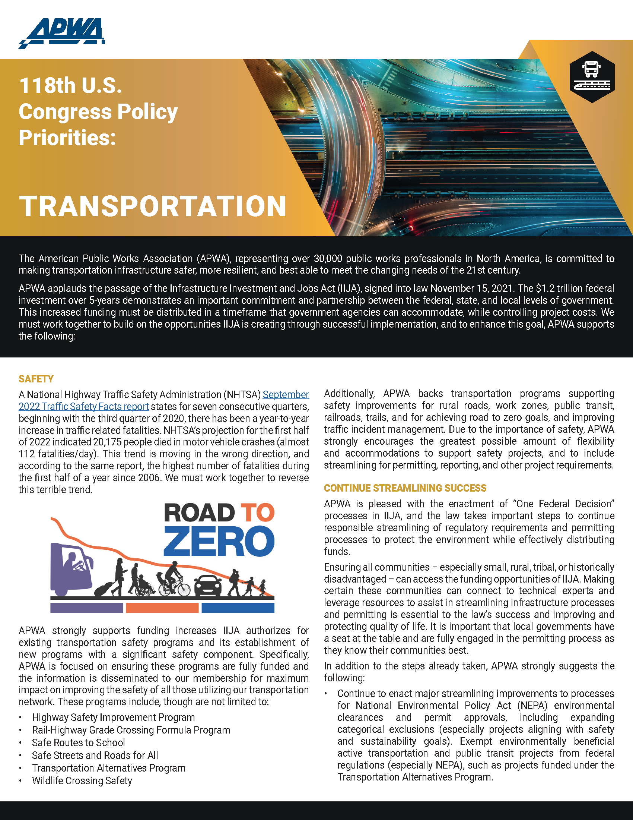
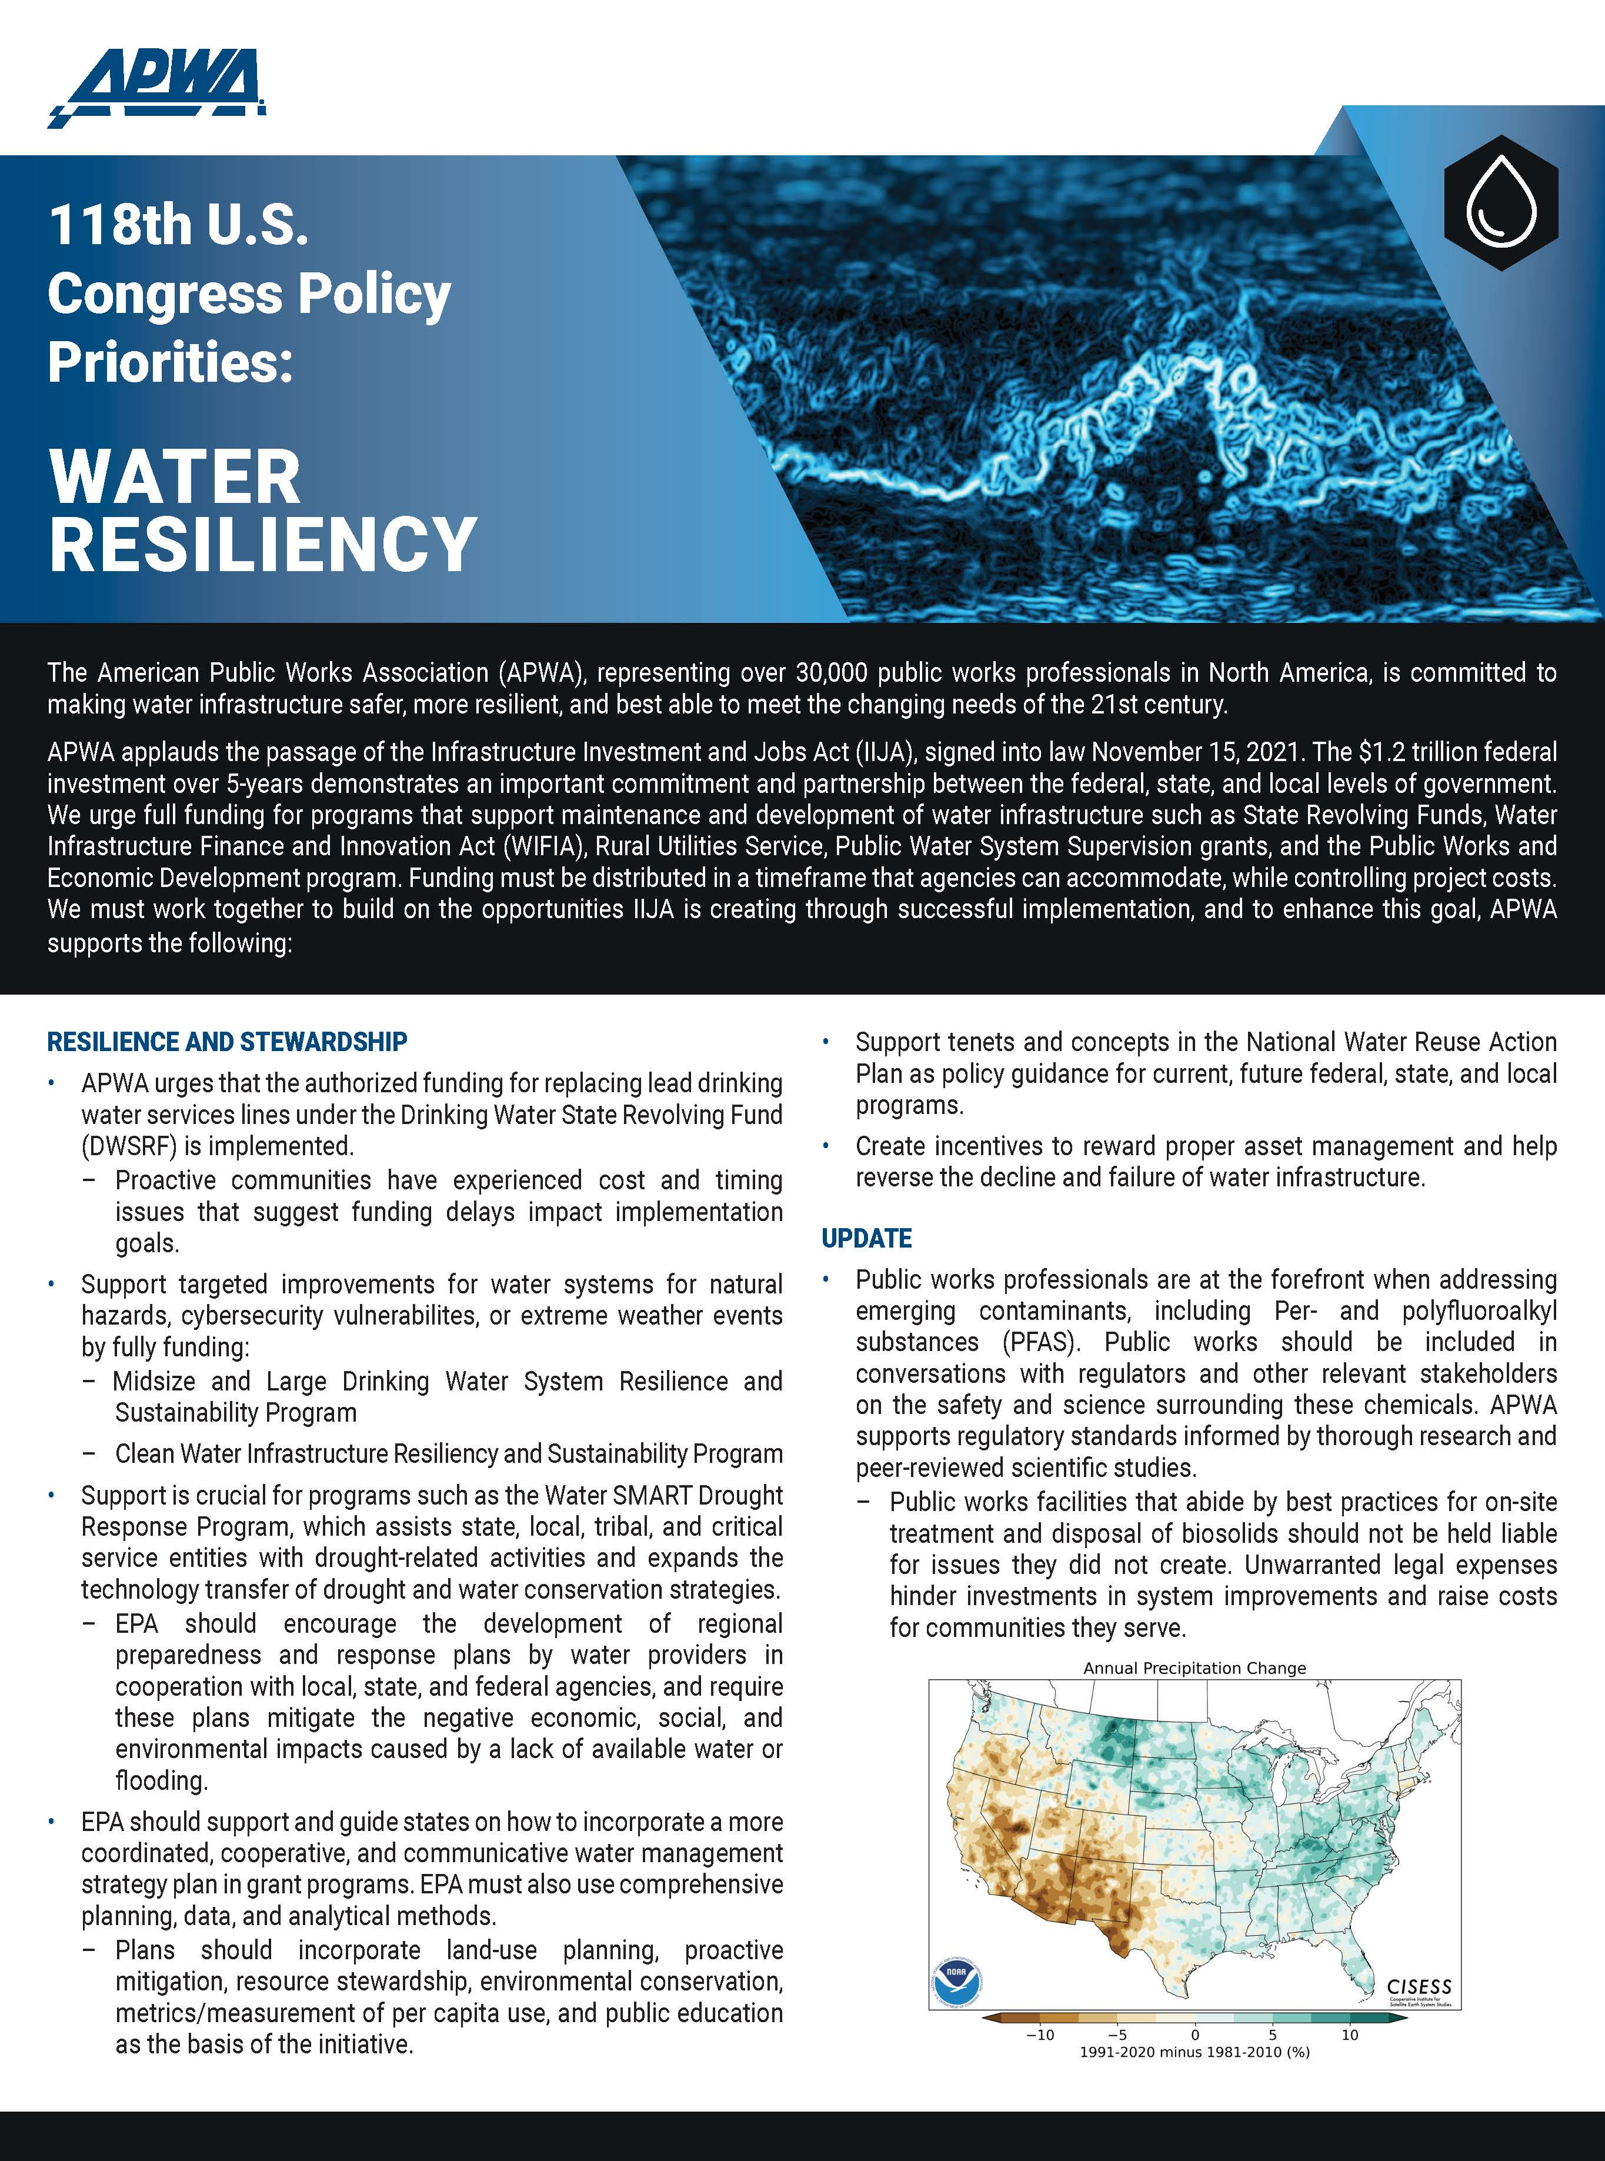
Public Policy Priorities
https://www.apwa.org/wp-content/uploads/118CongressPolicyPriorities_EmergMangmnt-Final.pdf
https://www.apwa.org/wp-content/uploads/118CongressPolicyPriorities_Transportation-Final.pdf
https://www.apwa.org/wp-content/uploads/118th_Congress_Policy_Priorities_Water_Resiliency-1.pdf

Slide 5


Have Popcorn?

Slide 6

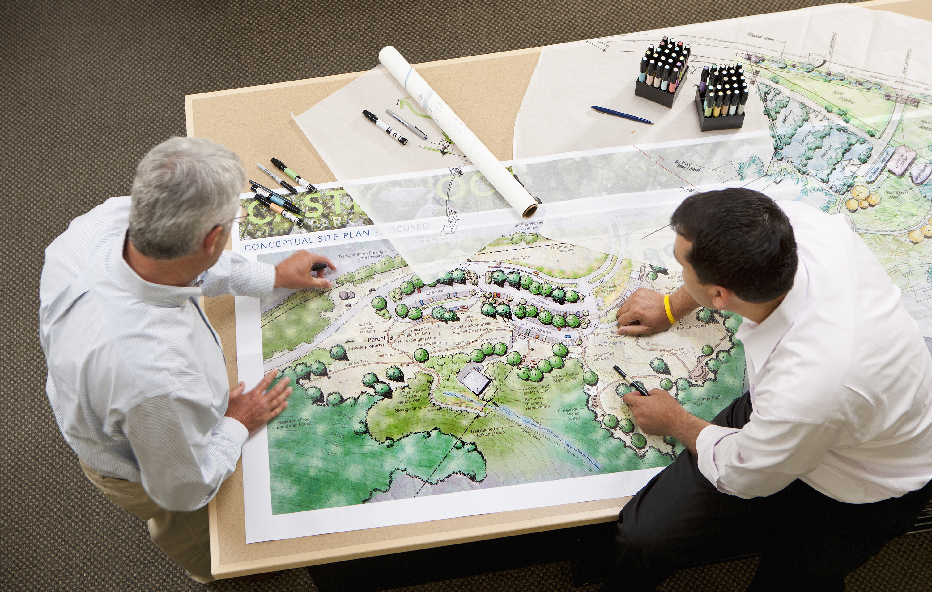

It Starts with You
Identify Priorities
Other APWA chapters
Colleagues
Like-minded groups
Elected/appointed officials
  Local/state agency executives
  Media
    Newspaper
    Radio
    TV
    Podcast
    PW influencers
Plan
Partner

Slide 7



APWA Government Affairs = Partner
Like you, we:
Advocate/educate electeds, policymakers, regulators
Monitor regs and bills impacting public works
Speak up when proposals affect public works
APWA Government Affairs here to:
Support chapter advocacy efforts
Train virtually and in-person

Slide 8
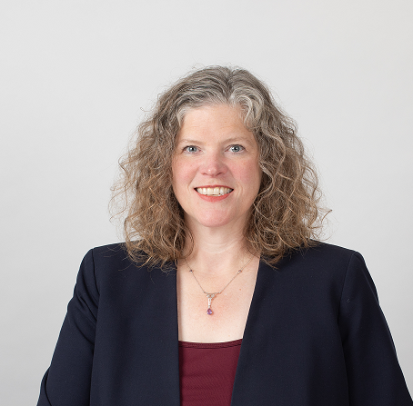



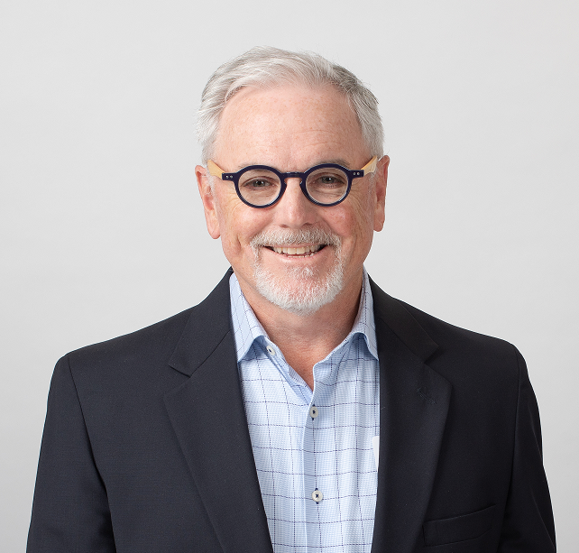
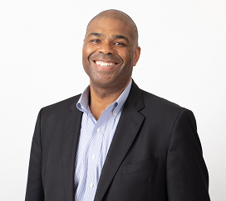
APWA GA Team
    Andrea Eales - @ajeales
    Director of Government & Public Affairs
    Jeff Finegan
    Government Affairs Associate
    Ryan McManus - @_Ryan_McManus_
    Government Affairs Manager
    Mark Shade - @apwamarkshade
    Government Affairs Media Manager
    Marty Williams - @APWAMarty
    Government Affairs Manager

Slide 9
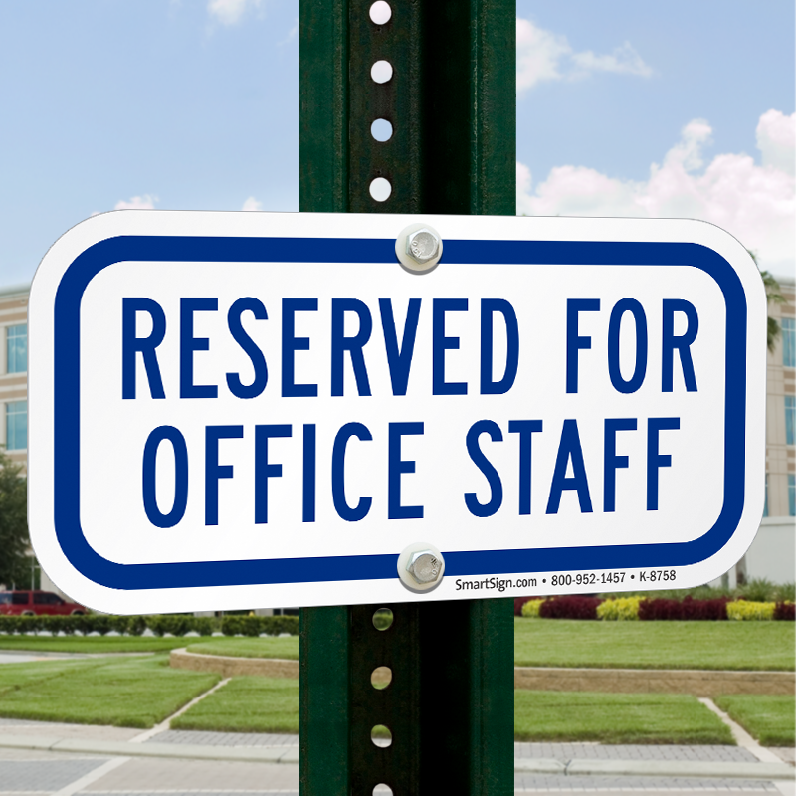
Federal Peeps to Inform
District
Chief of Staff
Constituent Services Director
District Director
Constituent Services Rep
Press Secretary
Capitol Hill
Chief of Staff
Legislative Assistant
Legislative Director
Legislative Correspondent
Comms Director
Scheduler
Press Secretary

Slide 10



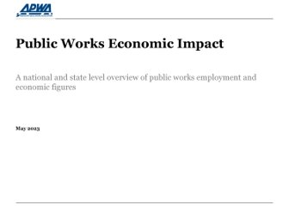



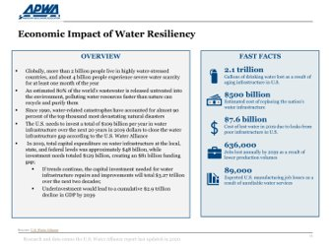

Advocacy Tools
https://www.linkedin.com/showcase/apwagovaffairs
https://twitter.com/APWAGovAffairs
Washington Report
Advocacy Letters
U.S. Infrastructure Law

Slide 11
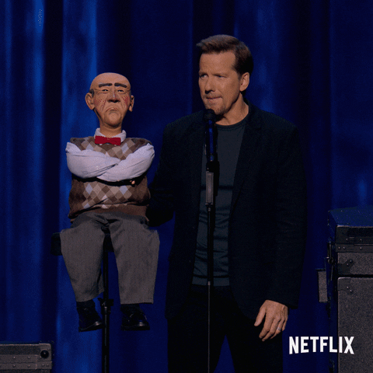


Does it Work?

Slide 12






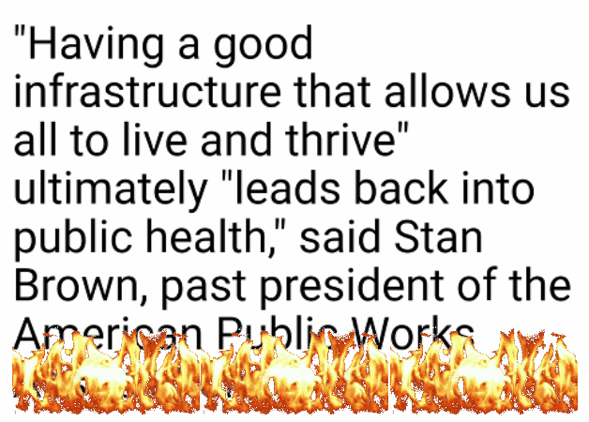
APWA Advocacy Success Story
“States spend federal COVID aid on roads, buildings, seawalls”

Slide 13
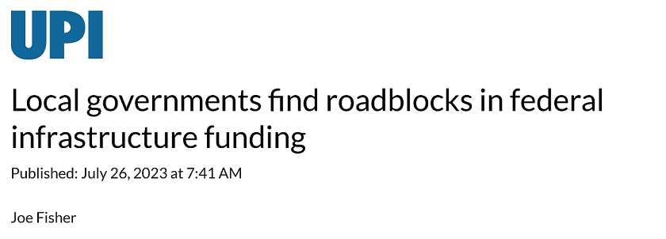
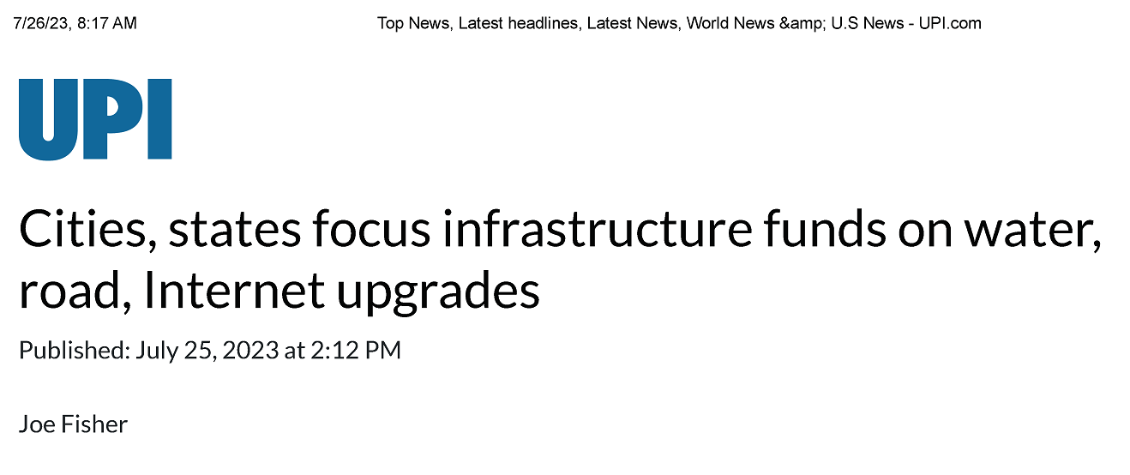
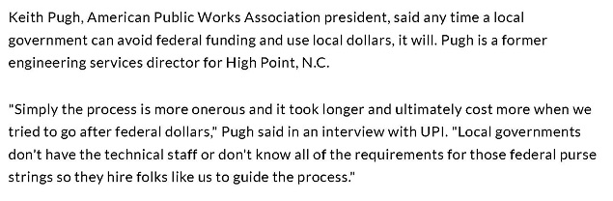
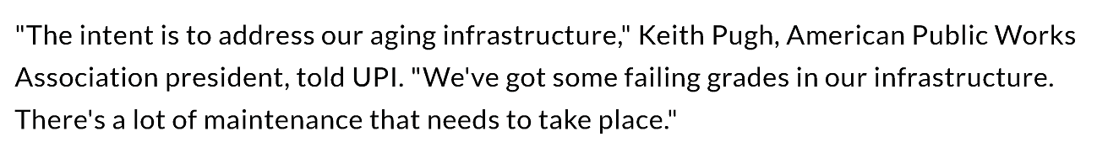
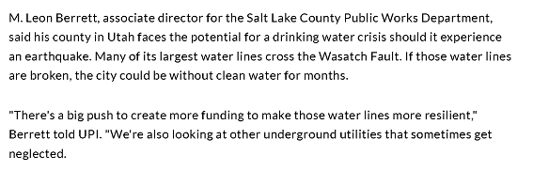
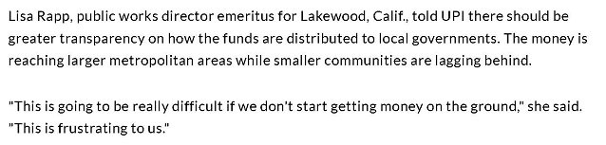
APWA Advocacy Success Story - 2

Slide 14
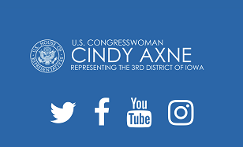
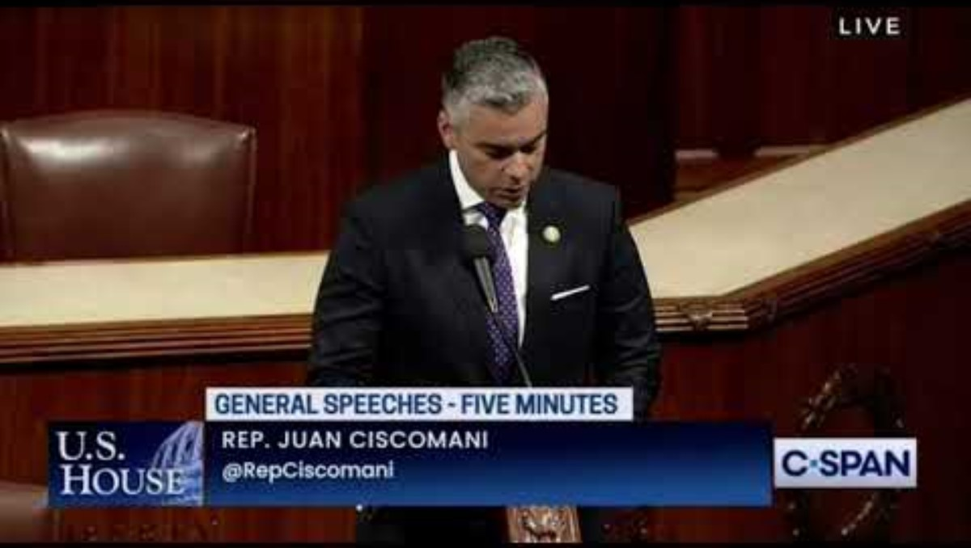
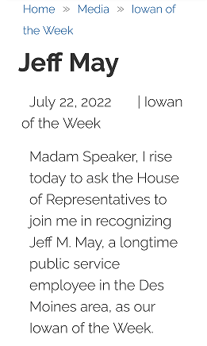
APWA Advocacy Success Story – 3a/b
https://www.youtube.com/watch?v=GqJkh5rbFTQ

Slide 15
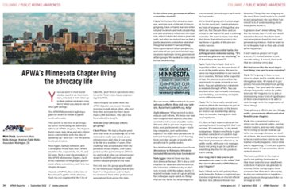
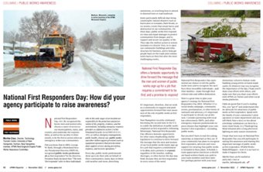
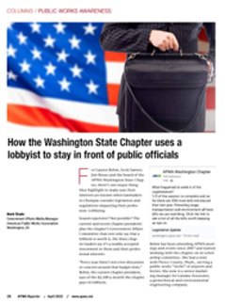
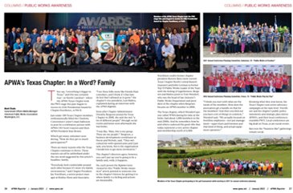
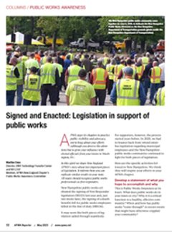
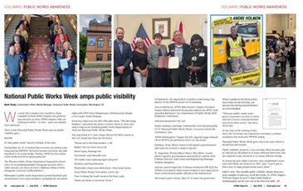

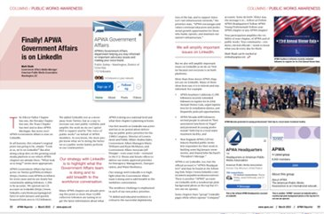

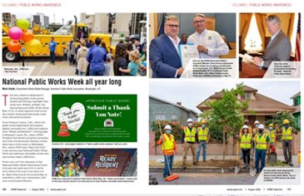
APWA Advocacy Success Story – 4

Slide 16

Thank You!
Andrea Eales - @ajeales
Director of Government & Public Affairs
aeales@apwa.org
Mark Shade - @apwamarkshade
Government Affairs Media Manager
mshade@apwa.org

