Slide 1
Per- and polyfluoroalkyl substances (PFAS)
A look at the state of regulations for forever chemicals

Slide 2
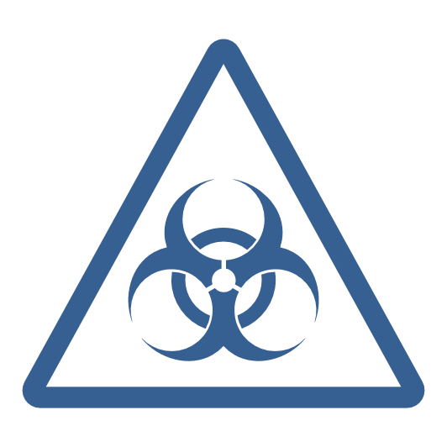






PFAS are persistent chemical pollutants that affect human health
PFAS are synthetic chemicals harmful to humans in small doses
  PFAS are widely used in industrial and consumer products for their water-resistant and non-stick properties.
  PFAS are also called “forever chemicals,” as they persist for years in the environment and in humans, where they can have adverse developmental and reproductive health effects and lead to an increased risk of cancer.
WHERE ARE PFAS?
Household nonstick & cleaning products
Military installations using flame retardants
$18T
Food packaging materials
Living organisms
Global societal costs of PFAS pollution per year, including remediation and health care costs.
Workplaces & production facilities
Air, water & soil
SOURCE Northeastern University, EPA, Politico, US Military Times, The Hill, CNN, ChemSec.
Notes:
Sources:
Annie Snider, “Trump EPA won’t limit 2 toxic chemicals in drinking water,” Politico, Jan. 28, 2019,
https://www.politico.com/story/2019/01/28/epa-toxic-chemicals-drinking-water-1124797
Tara Copp, “DoD: At least 126 bases report water contaminants linked to cancer, birth defects,” Military Times, April 26, 2018,
https://www.militarytimes.com/news/your-military/2018/04/26/dod-126-bases-report-water-contaminants-harmful-to-infant-development-tied-to-cancers/
“Mapping a contamination crisis,” Northeastern University Social Science Environmental Health Research Institute, June 7, 2017,
https://www.northeastern.edu/environmentalhealth/mapping-a-contamination-crisis/
Annie Snider, “Trump administration finally issues report on toxic chemicals,” Politico, June 20, 2018,
https://www.politico.com/story/2018/06/20/trump-report-toxic-chemicals-656319
Kelsey Tamborrino, “What’s in the spending deal?” Politico, December 17, 2019,
https://www.politico.com/newsletters/morning-energy/2019/12/17/whats-in-the-spending-deal-783760
Rebecca Beitsch, “EPA will regulate ‘forever chemicals’ in drinking water,” The Hill, February 20, 2020,
https://thehill.com/policy/energy-environment/483972-epa-will-regulate-forever-chemicals-in-drinking-water
Annie Snider, “EPA finalizes PFOA imports rule,” Politico, June 24, 2020,
https://www.politico.com/news/2020/06/24/epa-finalizes-pfoa-imports-rule-337006
“ChemSec identifies the top 12 PFAS producers in the world and reveals shocking societal costs,” ChemSec, May 22, 2023, https://chemsec.org/chemsec-identifies-the-top-12-pfas-producers-in-the-world-and-reveals-shocking-societal-costs/
Jen Christensen, “EPA proposes first standards to make drinking water safer from ‘forever chemicals,” CNN, March 15, 2023
“Basic Information on PFAs,” US Environmental Protection Agency, accessed March 24, 2023, https://www.epa.gov/pfas/basic-information-pfas

Slide 3
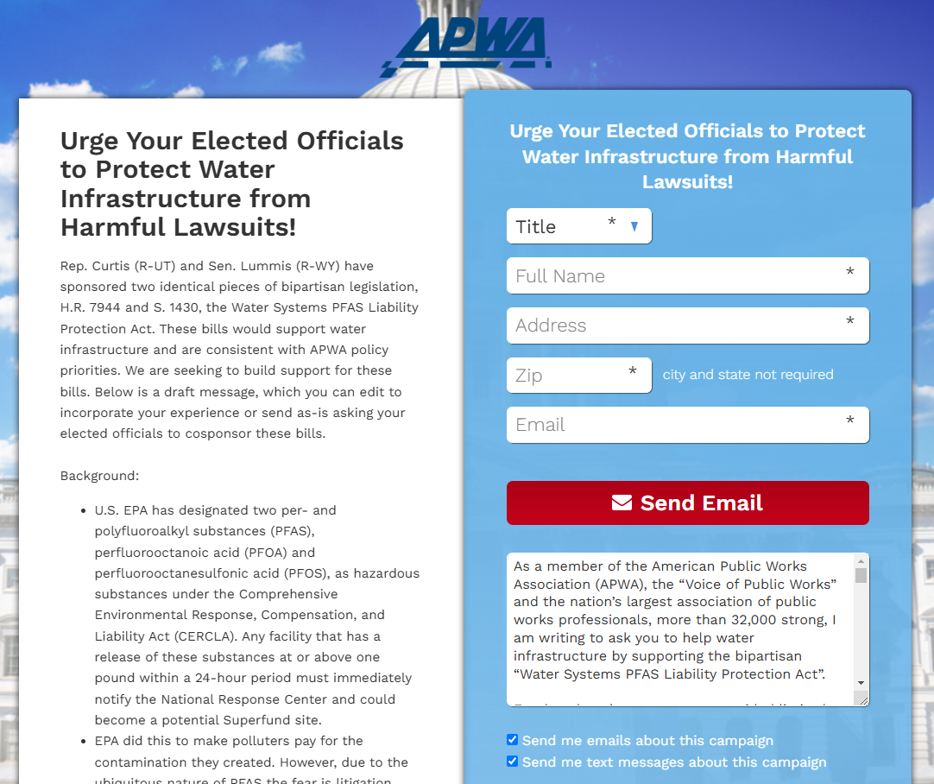
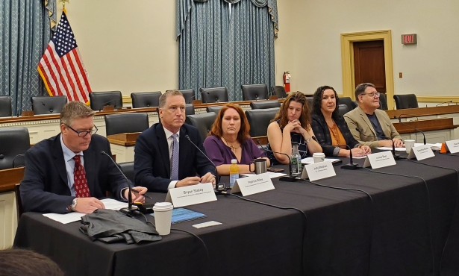
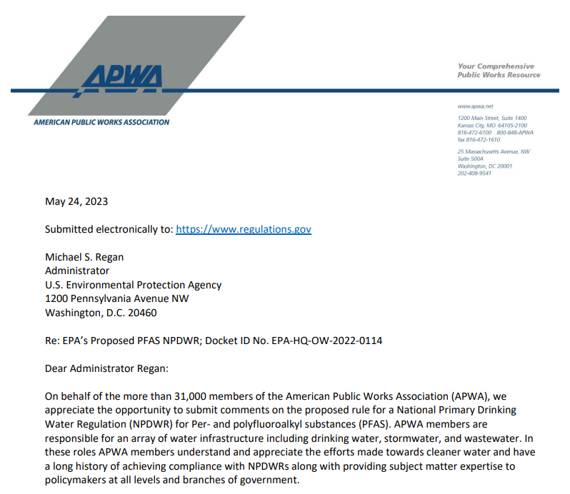
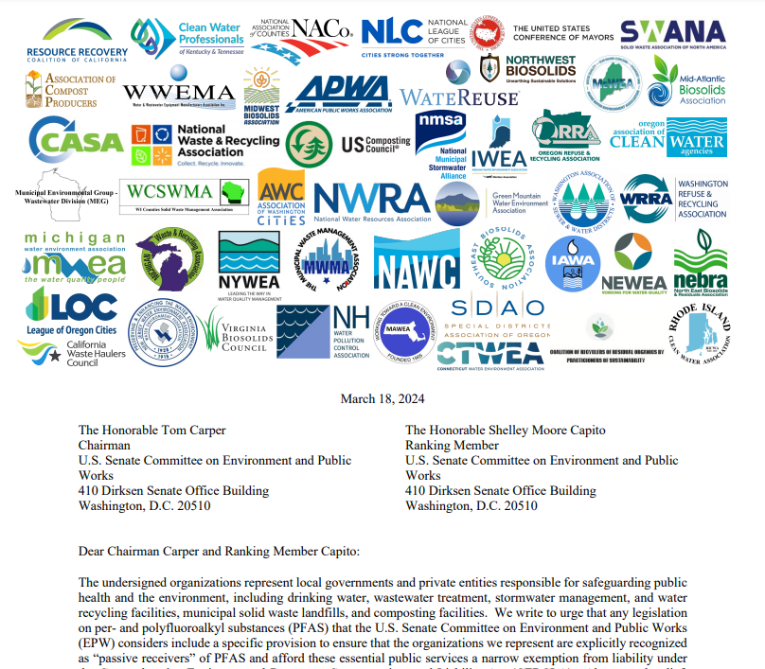
APWA Advocacy on PFAS
APWA has worked with other groups in the water space and members of the “passive receivers” coalition to advocate for appropriate resources and solutions to address PFAS contamination.
APWA has been a leading voice through press, editorials, letters to agencies and congressional and committee leadership along with briefings on the Hill for policymakers and legislative advocacy campaigns in support of beneficial legislation.

Slide 4



EPA's PFAS Strategic Roadmap
PFAS overview
On October 18, 2021, Michael Regan, the EPA administrator announced the PFAS Strategic roadmap which outlines the agency’s approach and upcoming rules to address PFAS.
The roadmap was initiated by the Biden Administration as part of a whole of government approach to reduce PFAS exposure to humans and their presence in the environment.
Scientists are still studying the effects of varying levels of PFAS exposures to humans.
Goals
1
2
3
Remediate
Research
Restrict
  Increase understanding of PFAS exposure, human health and ecological effects, and effective interventions by investing in innovation, research, and development.
  Develop comprehensive, proactive approached to prevent dangerous levels of PFAS from entering land, water and air.
  Accelerate and broaden clean up of PFAS contamination to protect the environment and human health.
SOURCE EPA, CDC, The White House.
Notes:
Sources:
“PFAS Chemicals Overview,” Centers for Disease Control and Prevention, June 24, 2020, https://www.atsdr.cdc.gov/pfas/health-effects/overview.html
“Potential Health Effects of Pfas Chemicals,” Centers for Disease Control and Prevention, June 24, 2020, https://www.atsdr.cdc.gov/pfas/health-effects/index.html?CDC_AA_refVal=https%3A%2F%2Fwww.atsdr.cdc.gov%2Fpfas%2Fhealth-effects.html
“Our Current Understanding of the Human Health and Environmental Risks of PFAS,” US Environmental Protection Agency, November 3, 2021, https://www.epa.gov/pfas/our-current-understanding-human-health-and-environmental-risks-pfas
“PFAS Strategic Roadmap: EPA's Commitments to Action 2021-2024,” US Environmental Protection Agency, October 18, 2021,
https://www.epa.gov/pfas/pfas-strategic-roadmap-epas-commitments-action-2021-2024
“Fact Sheet: Biden-Harris Administration Launches Plan to Combat Pfas Pollution.” The White House, October 18, 2021, https://www.whitehouse.gov/briefing-room/statements-releases/2021/10/18/fact-sheet-biden-harris-administration-launches-plan-to-combat-pfas-pollution/

Slide 5
Principles guiding EPA’s comprehensive approach to address PFAS
1
Consider the lifecycle of PFAS
Account for the lifecycle of PFAS, multiple pathways for exposure, their properties, and the ubiquity of their uses.
2
Get upstream of the problem
Work to prevent PFAS from entering the environment.
3
Hold polluters accountable
Hold polluters responsible for PFAS entering the environment and for PFAS remediation efforts.
4
Ensure science-based decision making
Invest in scientific research to better understand PFAS while identifying exposure levels that pose risks to humans and the environment.
Develop methods to test, measure, remove, and destroy forever chemicals.
5
Prioritize protection of disadvantaged communities
Ensure equitable access to solutions for disadvantaged communities.
SOURCE EPA.
Notes:
Sources:
“PFAS Strategic Roadmap: EPA's Commitments to Action 2021-2024,” US Environmental Protection Agency, October 18, 2021,
https://www.epa.gov/pfas/pfas-strategic-roadmap-epas-commitments-action-2021-2024

Slide 6



EPA & FDA restrictions for PFAS in drinking water and food packaging
The regulations promulgated under the Safe Drinking Water Act (SDWA) leverage funding from the Infrastructure Law for PFAS testing and treatment.
DRINKING WATER
BIPARTISAN INFRASTRUCTURE LAW FUNDING
New standards (first ever in the US) set maximum contaminant levels at 4.0 ppt.
Water utility systems will have 5 years to test and treat contaminated water.
A 2023 study found that half of US tap water is contaminated with PFAS.
$9B
Funding for communities with PFAS-contaminated drinking water
$12B
Funding for general drinking water improvements
FOOD PACKAGING
In February 2024, the FDA announced food packaging with PFAS is no longer being sold in the US.
The announcement came after a commitment by manufacturers to phase out selling these materials.
At least 12 states regulate PFAS in food packaging.
“Drinking water contaminated with PFAS has plagued communities across this country for too long. That is why President Biden has made tackling PFAS a top priority.”
Michael Regan, EPA Administrator
SOURCE EPA, FDA, CBS News, Packaging Digest.
Notes:
Sources:
“Biden-Harris Administration Finalizes First-Ever National Drinking Water Standard to Protect 100M People from PFAS Pollution,” EPA, April 10, 2024, https://www.epa.gov/newsreleases/biden-harris-administration-finalizes-first-ever-national-drinking-water-standard#:~:text=EPA%20is%20setting%20enforceable%20Maximum,are%20feasible%20for%20effective%20implementation.
Tracy Wholf, “EPA announces first-ever national regulations for ‘forever chemicals’ in drinking water,” CBS News, April 10, 2024, https://www.cbsnews.com/news/epa-first-ever-drinking-water-regulations-pfas-forever-chemicals/
“FDA, Industry Actions End Sales of PFAS Used in US Food Packaging,” FDA, February 28, 2024, https://www.fda.gov/news-events/press-announcements/fda-industry-actions-end-sales-pfas-used-us-food-packaging#:~:text=Today%2C%20the%20U.S.%20Food%20and,like%20fast%2Dfood%20wrappers%2C%20microwave
Jeffery Hunter, “Unpacking PFAS Food Packaging Regulations in the US,” Packaging Digest, September 19, 2023, https://www.packagingdigest.com/food-safety/unpacking-pfas-food-packaging-regulations-in-the-us

Slide 7
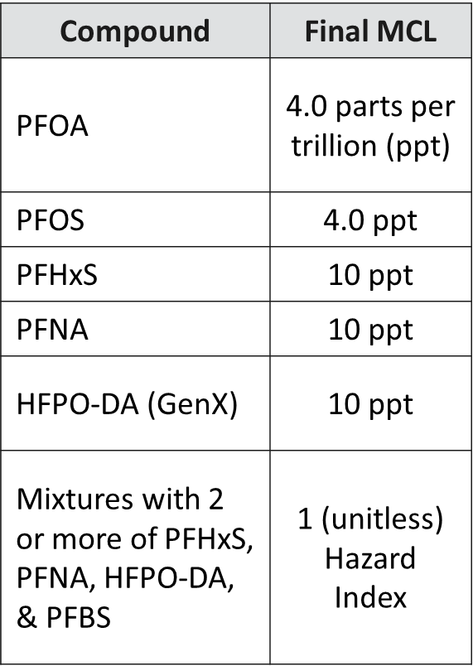
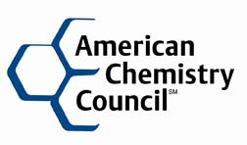
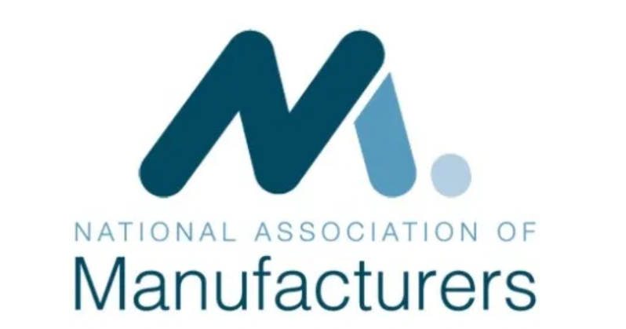
PFAS National Primary Drinking Water Regulation Specifics
Standards finalized in April 2024, litigation and the Trump administration could significantly alter compliance timeline and levels.
Public water systems have 3 years to complete initial monitoring, followed by ongoing compliance monitoring. Systems must provide the public with information on levels in their drinking water beginning in 2027 and have 5 years to reduce PFAS that exceed maximum contaminant levels (MCLs).
The National Association of Manufacturers and the American Chemistry Council filed a petition asserting the standards exceed EPA authority under the SDWA and they are arbitrary and capricious.
Similar challenge being made by the American Water Works Association and the Association of Metropolitan Water Agencies who said EPA "did not rely on the best available science" in developing the rule and it conflicts with 1996 SDWA amendments.

Slide 8
Utilities in nearly every state have reported contamination above the MCLs
Number of public drinking water utilities reporting PFAS contamination above the limit
■ 0 ■ 1-10 ■ 11-20 ■ 21 +
WA
MT
ND
ME
OR
MN
VT
ID
SD
WI
NY
NH
WY
MI
NV
NE
IA
PA
MA
UT
IL
IN
OH
RI
CA
CO
KS
MO
KY
WV
VA
CT
AZ
TN
NC
NJ
NM
OK
AR
SC
DE
MS
AL
GA
MD
AK
TX
LA
HI
FL
SOURCE Environmental Working Group.
Notes:
Sources:
“PFAS Contamination in the US,” Environmental Working Group, Accessed April 24, 2024, https://www.ewg.org/interactive-maps/pfas_contamination/map/

Slide 9
States that released health advisories and published PFAS contaminant level guidelines
Several states proposed or established PFAS standards prior to EPA
Proposed standards At least one established standard
Vermont established a drinking water health advisory
California established response and notification levels
New Jersey adopted PFOA and PFOS regulations in 2020
At the start of 2021, Illinois issued health advisories for five PFASs
SOURCE Association of State Drinking Water Admin., Cape May County Herald.
Notes:
Sources:
“Per- and Polyfluoroalkyl Substances (PFAS) State Drinking Water Program Challenges,” Association of State Drinking Water Administrators, accessed December 21, 2021,
https://www.asdwa.org/pfas/
“NJ Makes Regulatory History; Safe Drinking Standard for PFNA Adopted,” Cape May County Herald, September 4, 2018,
https://www.capemaycountyherald.com/news/environment/article_75eb39f6-b065-11e8-b9d8-ffcb34d6e276.html

Slide 10

State spotlight: New Jersey
“With the adoption of these standards, New Jersey continues to lead the nation in protecting public health and the environment…”
– Commissioner Catherine R. McCabe
Overview
New Jersey was the first state to test for PFAS in drinking and groundwater and in 2018, was the first to set a maximum contaminant level for PFNA (a type of PFAS)
EPA tests from 2013-2015 discovered PFOS in 3.4% of New Jersey drinking water, almost double the national average
In June of 2020, New Jersey adopted a rule considering PFAS hazardous substances and mandating that drinking water and groundwater in New Jersey can have no more than 14 ppt for PFOA and 13 ppt for PFOS
New Jersey’s rule created one of the strictest state-level PFAS standards in the US
SOURCE NPR, Politico, EIN PressWire.
Notes:
Sources:
Susan Phillips, “New Jersey proposes PFAS regulations for groundwater; EPA regulations delayed by shutdown,” State Impact/NPR, Jan. 21, 2019,
https://stateimpact.npr.org/pennsylvania/2019/01/21/new-jersey-proposes-pfas-regulations-for-groundwater-epa-regulations-delayed-by-shutdown/
“Affirming National Leadership Role, New Jersey Publishes Formal Stringent Drinking Water Standards for PFOA and PFOS (20/P025),” EIN PressWire, June 4, 2020,
https://www.einnews.com/pr_news/518390532/affirming-national-leadership-role-new-jersey-publishes-formal-stringent-drinking-water-standards-for-pfoa-and-pfos-20-p025
Kelsey Tamborrino, “The latest salvo in states' permitting fight,” Politico, June 2, 2020,
https://www.politico.com/newsletters/morning-energy/2020/06/02/the-latest-salvo-in-states-permitting-fight-788115

Slide 11
12 states prohibited distribution of food packaging with PFAS
WA
MT
ND
ME
OR
MN
VT
ID
SD
WI
NY
NH
WY
MI
NV
NE
IA
PA
MA
UT
IL
IN
OH
RI
CA
CO
KS
MO
KY
WV
VA
CT
AZ
TN
NC
NJ
NM
OK
AR
SC
DE
MS
AL
GA
MD
AK
TX
LA
HI
FL
SOURCE Packaging Digest.
Notes:
Sources:
Jeffery Hunter, “Unpacking PFAS Food Packaging Regulations in the US,” Packaging Digest, September 19, 2023, https://www.packagingdigest.com/food-safety/unpacking-pfas-food-packaging-regulations-in-the-us

Slide 12
A major source of contamination is military installations, primarily Air Force sites
Environmental investigations on US military installations
■ Installations with known or suspected releases of PFOS/PFOA
■ Installations sampled with results exceeding EPA PFOS/PFAS
advisory levels
Overview
PFOA/PFOS contamination in groundwater around military installations likely results from foam fire retardant used to extinguish aircraft fires.
At twenty-four of the identified installations, PFO/PFOS levels exceeded EPA health advisory limits.
The DOD’s PFAS task force released a report in March 2020 updating the total number* of military installations with known or suspected releases of PFOA/PFOS to 651 as of the end of FY 2019.
In 2024 the DOD stated it will prioritize initially addressing drinking water with detected levels of PFAS that are three times or above the MCLs from EPA.
*The report did not update the number of identified installations by military branch
SOURCE Department of Defense (DOD), US Accountability Office.
Notes:
Sources:
“Addressing Perfluorooctane Sulfonate (PFOS) and Perfluorooctanic Acid (PFOA),” US Department of Defense, March 2018,
http://www.oea.gov/resource/addressing-perfluorooctane-sulfonate-pfos-and-perfluorooctanoic-acid-pfoa
“Status of DOD Efforts to Address Drinking Water Contaminants Used in Firefighting Foam,” US Government Accountability Office, September 26, 2018,
https://www.gao.gov/products/GAO-18-700T
“Per- and Polyfluoroalkyl Substances (PFAS) Task Force Progress Report,” US Department of Defense, March 2020, https://media.defense.gov/2020/Mar/13/2002264440/-1/-1/1/PFAS_Task_Force_Progress_Report_March_2020.pdf

Slide 13

Litigation against PFAS manufacturers and settlements for water systems
Background: Aqueous Film-Forming Foams (AFFF) Products Liability Litigation, Multidistrict Litigation No. 2873
Approximately 100 cases were consolidated into multidistrict litigation before the U.S. District Court of South Carolina
The cases involve varied causes of action and claims relating to PFAS.
Generally, plaintiffs allege that AFFFs containing PFOA or PFOS contaminated groundwater near military bases, airports, and industrial sites where they were used to extinguish liquid fuel fires.
Plaintiffs allege they were caused personal injury, a need for medical monitoring, or economic losses such as property damage.
December 2018
June 2023
April 2024
2025 & Beyond
District of South Carolina receives transfer order from the Judicial Panel on Multidistrict Litigation.
DuPont and spinoff companies reach a $1.18 billion deal with about 300 drinking water providers.
Court approves $10.5-12.5 billion settlement with 3M over PFAS in public drinking water systems
Recipients continue filing claims and ongoing litigation regarding contamination in stormwater and wastewater.
Spotlight: Guertin v. Michigan et al.
    In 2020, the Supreme Court declined review of a 2019 ruling allowing plaintiffs to argue a due process violation of “bodily integrity” as a result of the Flint water crisis.
    This decision set a precedent for people exposed to contaminants to sue environmental regulators.
    The Supreme Court’s action could be a significant driver for states to continue to regulate and pass new legislation shifting responsibility for PFAS contamination to chemical manufacturers.
SOURCE Inside EPA, US District Court District of South Carolina.
Notes:
Sources:
“Aqueous Film-Forming Foams (AFFF) Products Liability Litigation MDL No. 2873, Introduction,” United States District Court District of South Carolina, accessed December 19, 2019, https://www.scd.uscourts.gov/mdl-2873/
“Aqueous Film-Forming Foams (AFFF) Products Liability Litigation MDL No. 2873, Current developments,” United States District Court District of South Carolina, accessed June 26, 2020, https://www.scd.uscourts.gov/mdl-2873/current.asp
“High Court’s Cert Rejection Of ‘Bodily Integrity’ Case Could Aid PFAS Suits,” InsideEPA, February 26, 2020, https://insideepa.com/daily-news/high-court%E2%80%99s-cert-rejection-%E2%80%98bodily-integrity%E2%80%99-case-could-aid-pfas-suits

Slide 14



Hazardous Designation for PFOA & PFOS under CERCLA (Superfund)
In April 2024, two PFAS were designated as hazardous substances, there are concerns about liability protections for entities such as water infrastructure who were not responsible for the creation of these chemicals, but now must invest and manage them. This further complicates costs of compliance with MCLs amidst uncertainty of contamination levels for some systems and legal risks.
The National Waste & Recycling Association, the U.S. Chamber of Commerce, and the Associated General Contractors have challenged whether EPA misinterpreted CERCLA, provided adequate opportunity to comment, offered reasonable explanation for the rule, appropriately considered associated costs, and violated the Constitution by “imposing retroactive liability.” They also allege EPA acted capriciously and may raise additional issues.
Legislators continue to support research and efforts to reduce exposure though action by Congress is expected to be limited to the inclusion of provisions in appropriations bills. Congress may act on liability protections for passive receivers, which would likely include water infrastructure.

Slide 15
Destruction & Disposal Guidance and Effluent Limitations Guidelines (ELGs)
New destruction and disposal guidance that was released in 2024, may be updated again as more research is done on identifying available and effective methods to remediate, dispose of and destroy PFAS contamination.
After substantial delays, EPA inches closer to proposing first-ever limits on PFAS in wastewater and sewage, the latest step in Preliminary Effluent Guidelines Program Plan 15, which laid out regulatory goals for limiting substances in landfill leachate and from industrial facilities.
Finalizing any ELGs though will fall to the Trump administration. PFAS compounds subject to regulation have yet to be announced and while there is hope that this will help address sources of PFAS, there are concerns about potential impacts on discharges from public works facilities and how this will coincide with other rules such as those for biosolids.

