Slide 1
Chapter Communications
Jared Shilhanek
Chief Growth Officer
APWA

Slide 2

Why do members join APWA?
Networking
Professional development
Content: training/knowledge
Other reasons
  Peer pressure
  Friends
  Corporate memberships

Slide 3
The Importance of Chapter Marketing
Membership: recruitment and retention
Strengthen relationships with your members
Drive attendance for chapter events
Revenues/fundraising
Deliver content and experiences

Slide 4

Chapter Marketing
Chapter
Leaders
Chapter
Members

Slide 5
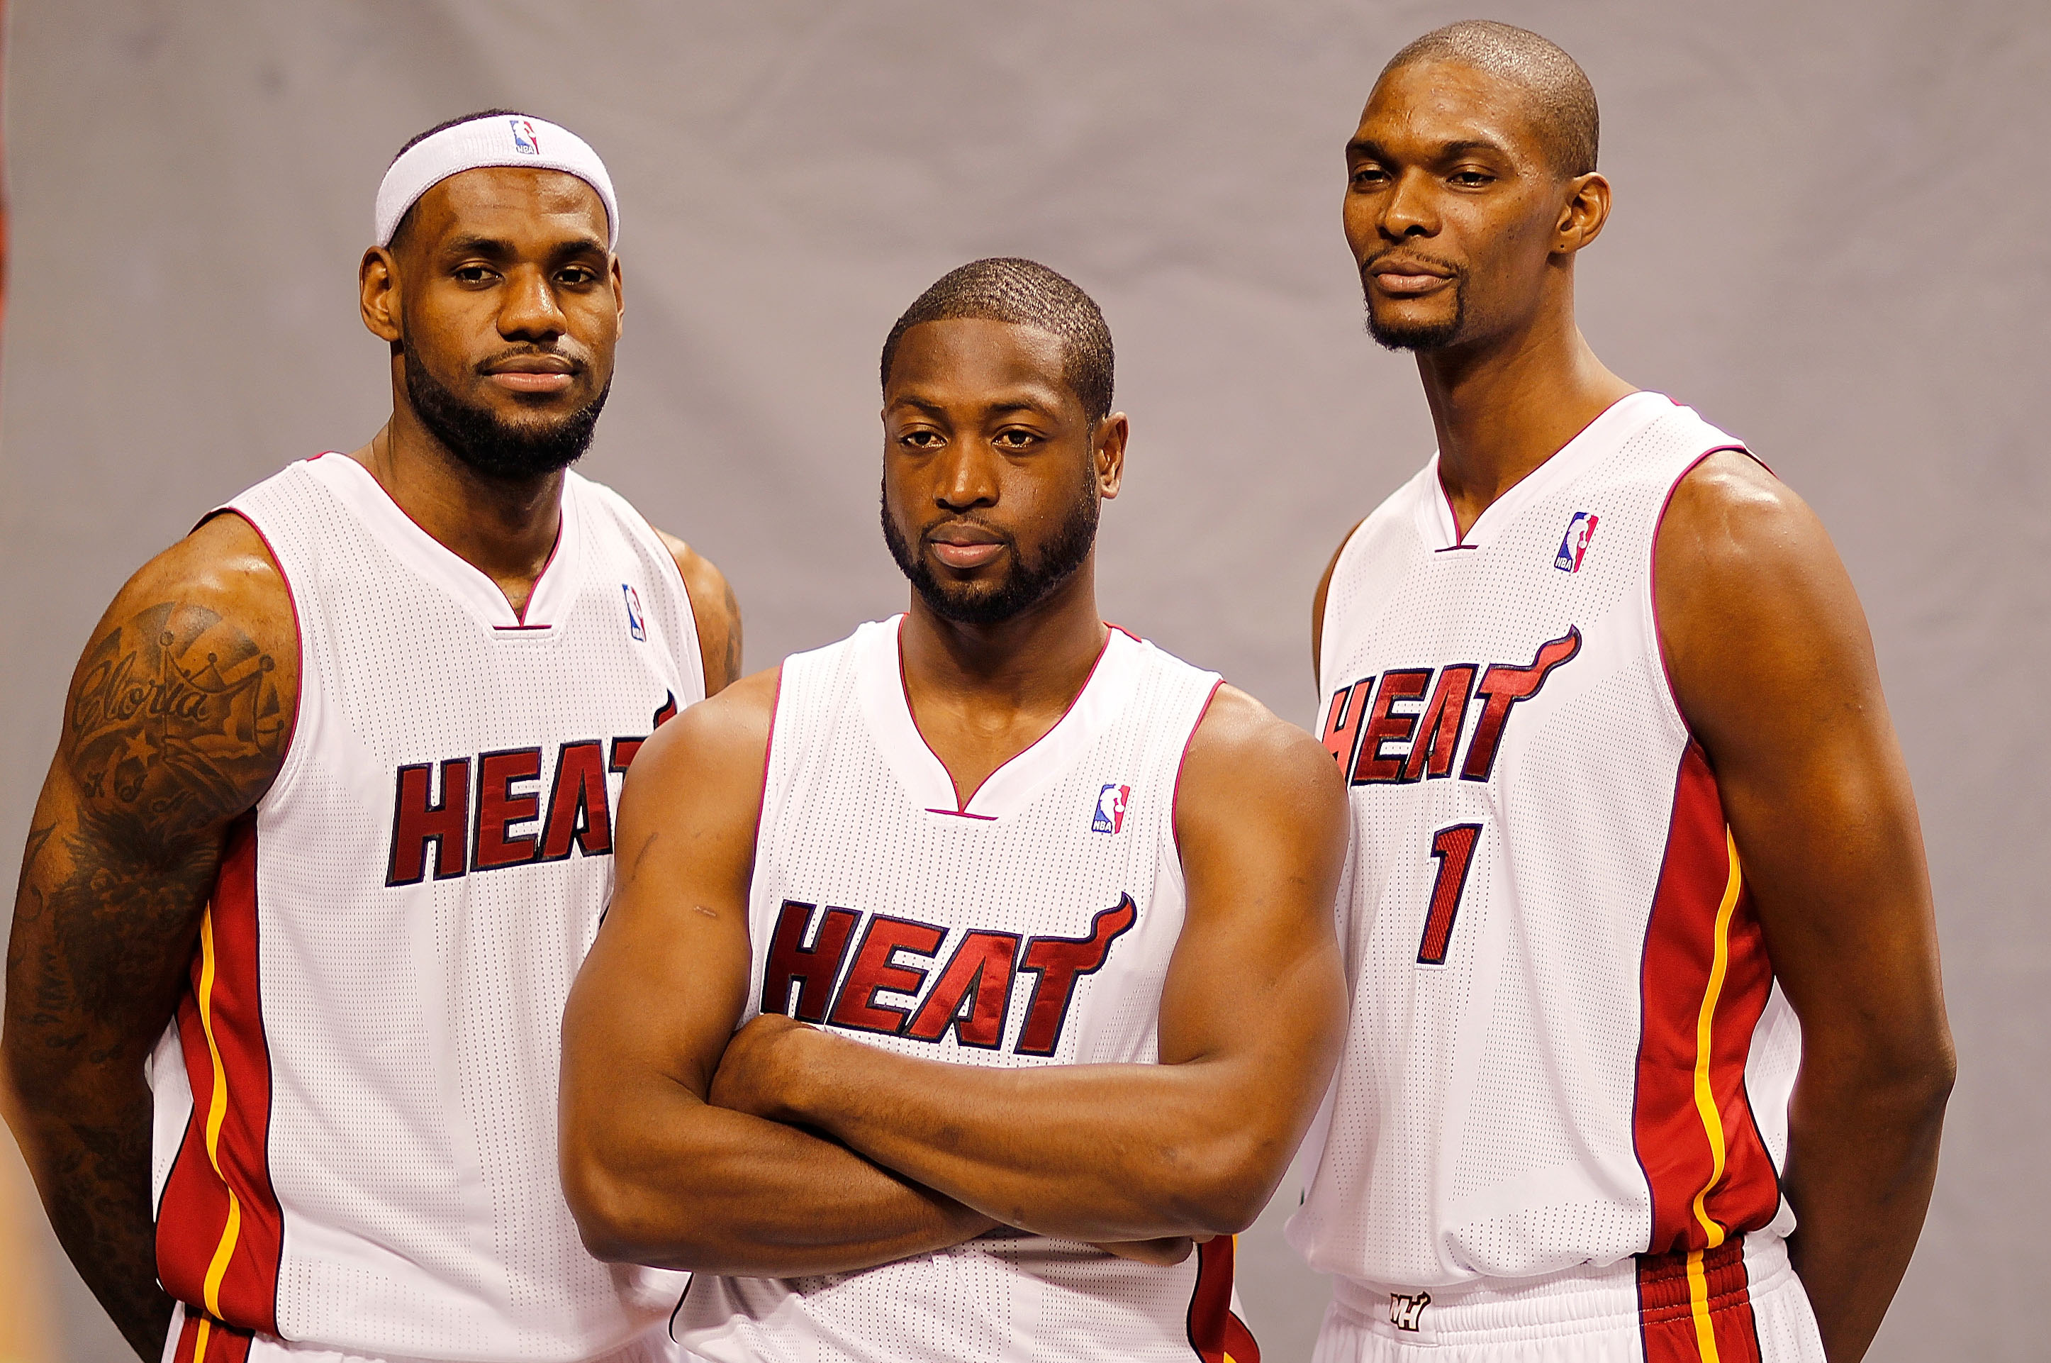
The “Big 3” in Chapter Marketing
Chapter Website
Email
Social Media

Slide 6


Slide 7

Chapter Website = Your First Impression
How to make a good first impression:
Headlines
Photos
Copy
Updates/Relevancy
Calendar
Contact information

Slide 8
Email Best Practices
Use images and video everywhere you can
  Images = +25% open rate
  Videos = +50% open rate
Spend time writing a quality subject line
Time it right
  Tuesday-Thursday at noon
  Sunday???

Slide 9

Email Best Practices (cont.)
Keep up with your lists
Get personal
Know your audience
Use clear and concise CTAs
Be relevant and timely
Edit and proofread; Short & sweet
Test everything… Then test it again
Measure your results

Slide 10
APWA Email Resources
Chapter Lists
- Always up-to-date on the
Chapter Leader Resources
website (clr.apwa.net)
APWA Email Sender/Tool
- Simple, easy-to-use
- Not the most robust tool
(non-html)

Slide 11

Third Party Email Platforms
Capterra: 5 Best Free Email Marketing Platforms
Overviews
Ratings/reviews
Pros/cons
Pricing information
List capabilities
Screenshots
Links to in-depth reviews

Slide 12

Sample Event Marketing Campaign

Slide 13
Sample Event Marketing Campaign
Mark Your Calendar – When website goes live
Registration Open – 3 months out
Keynote Speaker(s) – 2 ½ months out
Education Sessions – 2 months out
Early Bird Deadline – 1 ½ months out
Special Events – 1 month out
Last Chance! – 2 weeks out

Slide 14

Email Resources: HubSpot

Slide 15

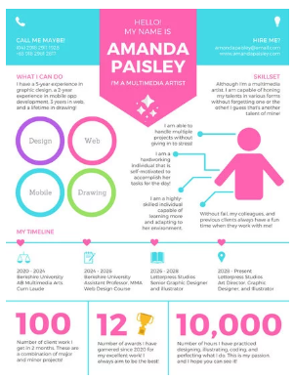

Email Resources: Canva

Slide 16
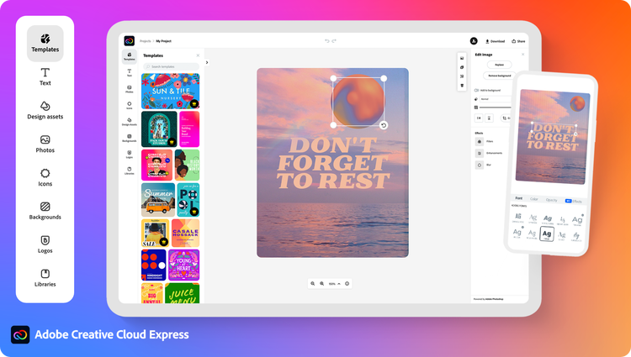
Email Resources: Adobe Express

Slide 17

Email Resources: ReallyGoodEmails.com

Slide 18
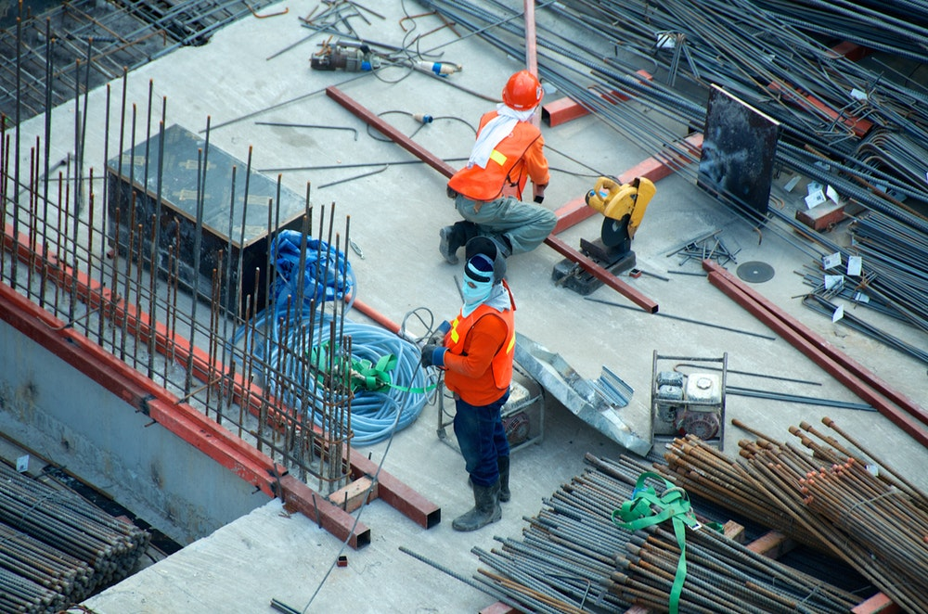
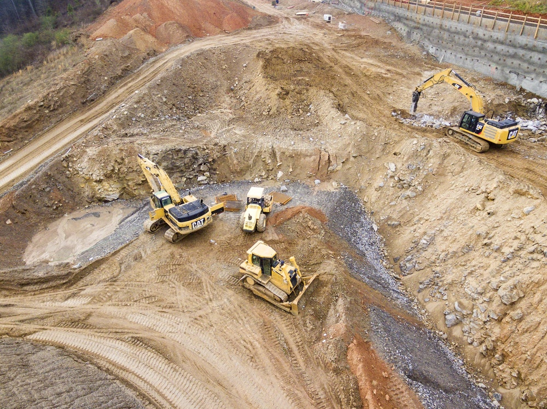


Email Resources: Free Stock Photos
Unsplash.com
Stocksnap.io
Pixabay.com
Pexels.com
Wikimedia Commons
Google*

Slide 19

Social Media

Slide 20




The Importance of Chapter Social Media
Build brand awareness with your audience
Take your message/content to where the conversation is already happening
Strengthen and create personal relationships with your followers/audience
Engage in real-time conversation

Slide 21
Social Media—The Modern Megaphone
Often the first place people check for live updates on breaking news, projects, disasters, etc.
Social media allows you to:
  Build public trust in your chapter
  Raise your profile, demonstrate your influence
  Broadcast your efforts to individuals, organizations, elected officials, companies, traditional media, etc.

Slide 22
When to Post on Social Media?
Every day
Three times per week
Two times per week
Once a week
Once a month
Never

Slide 23
Getting Started on Social Media
Start by making a detailed one-month plan!
Channels you plan to post (Start with only a few)
Days of the week you plan to post
Number of times during a day you plan to post
Times
Topics
Pre-written captions

Slide 24
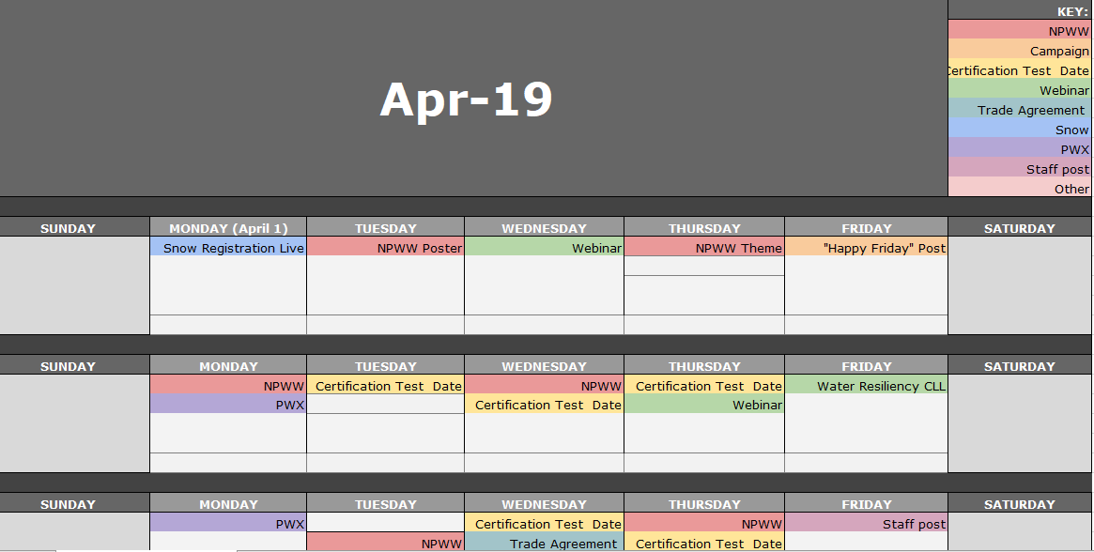
Social Media Content Calendar

Slide 25

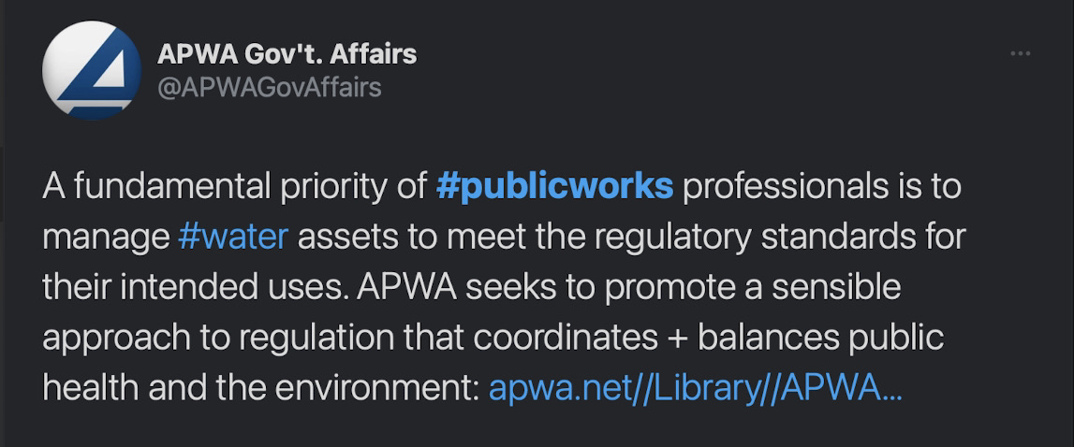
APWA Hashtags
#PWX2023
#Show4Snow
#NPWW
#ConnectingTheWorldThroughPW
#Publicworks

Slide 26
Create Connections with Quality Content
Pictures and videos
  Fun Fact: People only retain 10% of auditory content. If an image is paired with that same information, people retain 65%.
Upcoming events
Tools and resources
Engaging in current, relevant discussions
Sharing relevant news
Contests/Challenges/etc.

Slide 27
BREAKOUT!
In your breakout rooms, discuss the following:
What does your chapter’s social media efforts look like currently?
What processes does your chapter have in place for social media management (personnel, software, etc.)
Do you have any tips/tricks/resources that your chapter uses for social media that you’d like to share?

Slide 28
Post-Breakout Discussion

Slide 29


